Slide 1
(Open) Data Economy
Enabled & Powered by the Cloud
Challenges and Opportunities
Adomas Svirskas
President, National Software and Services Cluster
Invited Expert, EC Horizon 2020, DG CONNECT

Slide 2
Key Points
Data and information are resources of crucial importance to any country and society
Data is raw resource, like crude oil, yet its volume is growing (as opposed to oil ☺)
Considerable added value can be created using data creatively – Data Economy potential
Data Economy and Data Value Chain require proactive steps to create them

Slide 3
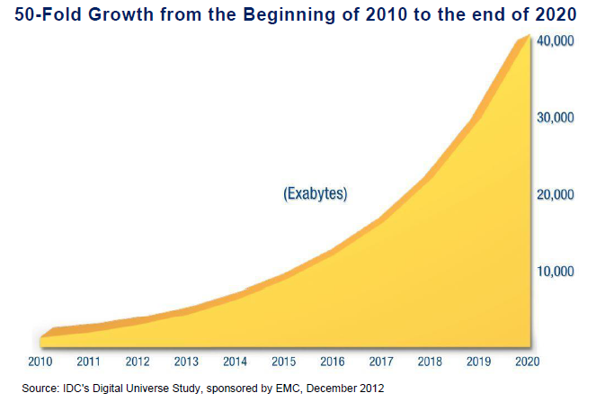
Digital Universe Keeps Exploding

Slide 4
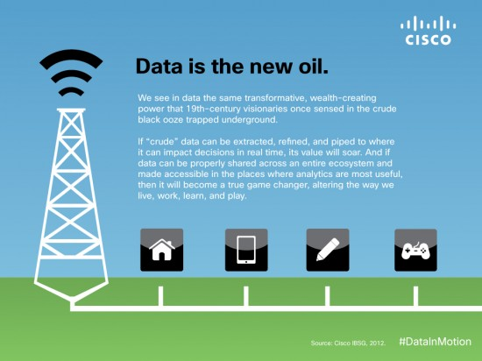

Data is the New Oil?
Extract
Refine
Deliver
Transform
Use for profit

Slide 5
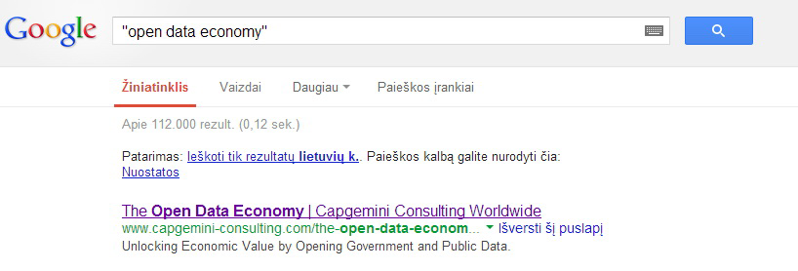
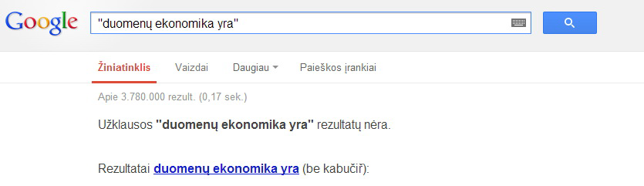
What is Data Economy?

Slide 6
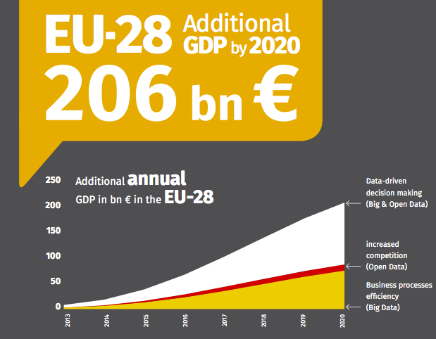
(Open) Data Economy Potential
European Public Sector Information (ePSI) Platform, http://www.epsiplatform.eu/

Slide 7
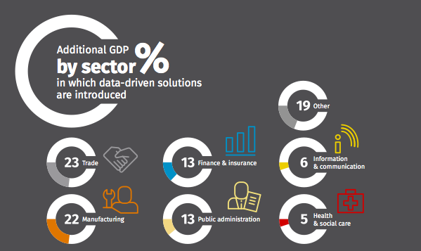
(Open) Data Economy Potential
European Public Sector Information (ePSI) Platform, http://www.epsiplatform.eu/

Slide 8
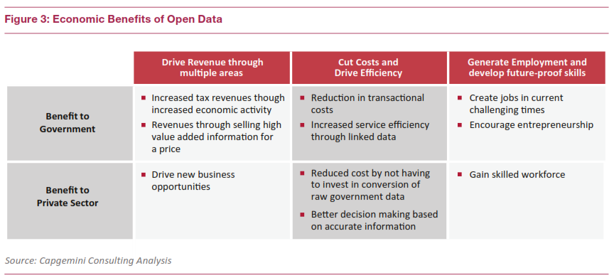
(Open) Data Economy Benefits
http://ebooks.capgemini-consulting.com/The-Open-Data-Economy/files/assets/basic-html/page1.html

Slide 9
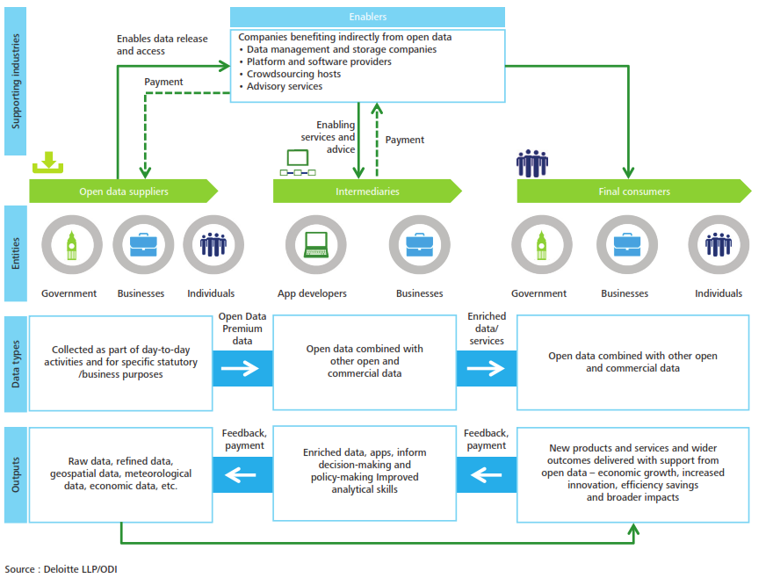
(Open) Data Ecosystem/Marketplace

Slide 10
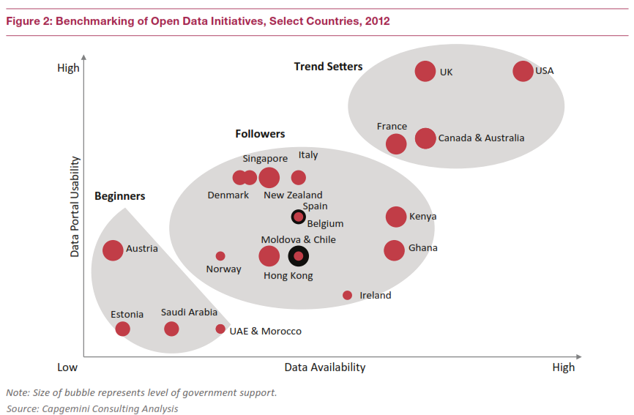
Open Data Survey Results

Slide 11

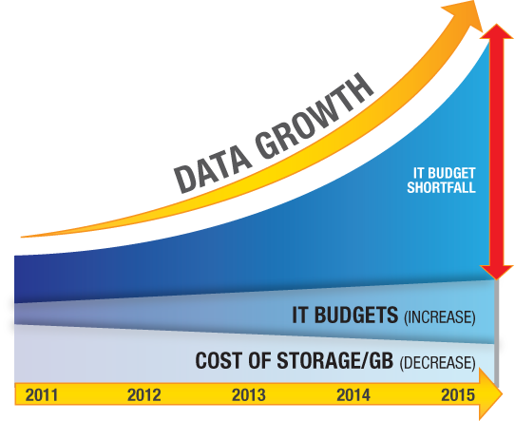
Data Governance – the Challenge
Cloud can help to overcome both business/organisational and technical challenges, if used properly.
© Permabit

Slide 12
Open Issues
Government, businesses and citizens create a lot of data, which is not used
Legislation and regulations need to be amended
Robust and reliable infrastructure is critical
Data Ecosystem(s)/Marketplace(s) need to be promoted and created
Standards need to be adopted
Good practices and WOW cases need to be identified and championed

Slide 13
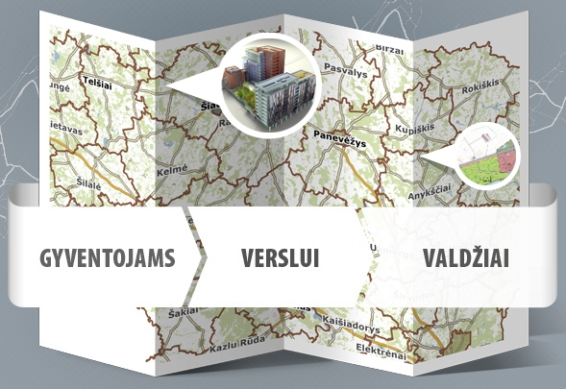
Regional Geo-Information Environment Service
REGIONAL GEO-INFORMATION ENVIRONMENT SERVICE
REGIA (www.regia.lt) developed and provided by Lithuanian Centre of Registers is a regional geo-information environment service is a powerful and handy tool specifically developed for local authorities: their people, civil servants and therein operating businesses.
The purpose of REGIA is to create favourable conditions for geography-based decision-making and to facilitate the exchange of information.
FOR
CITIZENS
FOR
BUSINESS
FOR GOVERNMENT

Slide 14
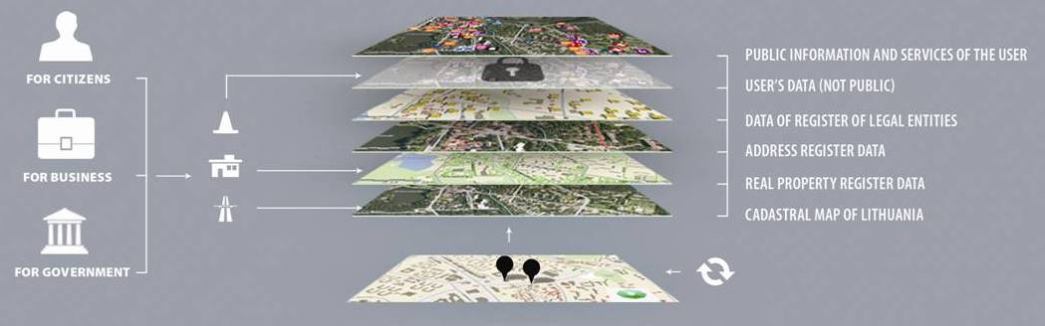
REGIA Anatomy and Operational Scheme
REGIA OPERATIONAL SCHEME
REGIA users can:
  create and manage their own data layers
  store and manage information or documents
  decide whether his data layer is publicly visible & who is entitled to use it
  services in the review mode are publicly accessible

Slide 15
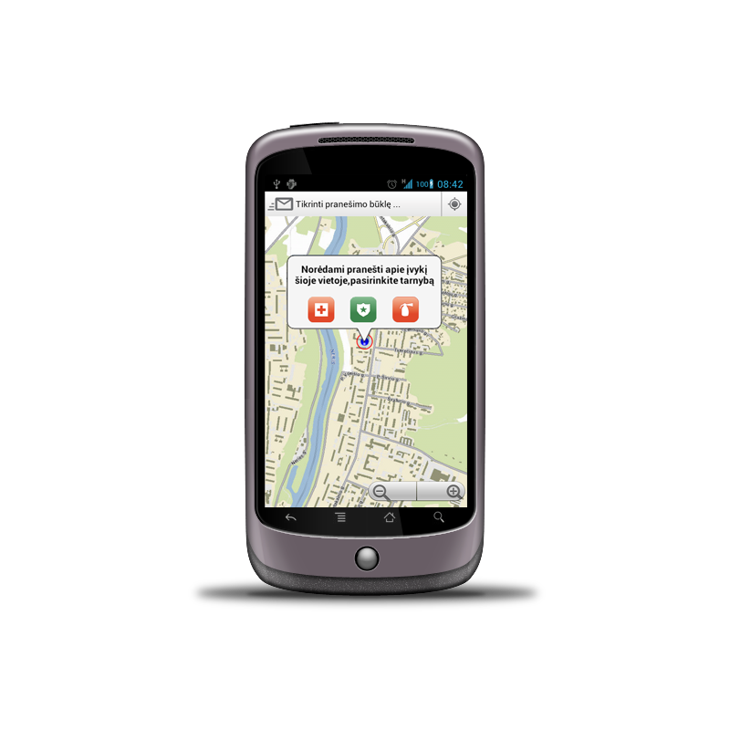
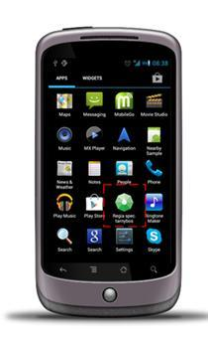






MOBILE MAPING E-SERVICES
Mobile Service for Citizen-Government Communication
Services are intended to notify a problem, for example
smartphone
mobile electronic signature
REGIA map

Slide 16











REGIA Cloud
REGIA CLOUD
ADDRESS REGISTER
REGISTER
OF LEGAL ENTITIES
REAL PROPERTY REGISTER
OTHER STATE REGISTERS DATA
SECR
SERVERS
IDENTFICATION PLATFORM
OTHER
E-SERVICESES
PROVIDERS & USERS DATA
MUNICIPALITY DATA

Slide 17
Thank you!
Q&A

