Slide 1



International conference
“Consolidation of Government Information Resources:
Cloud Computing Solutions”
November 27th, 2014, Vilnius
Towards Harmonization
of the Digital Markets in
the Cross-Border Cooperation
Vladimir Basko, Director General
Scientific and technological association «Infopark»
Promotion of socioeconomic development and encouragement of entrepreneurship by developing Cross-­‐border R&D and Innovation Network in Cloud Computing Area (LLB-2-142).
This project is funded by the European Union.

Slide 2

Presentation Plan
  Lithuania-Belarus Cross-border Cooperation.
  Why Digital Markets? Why Harmonization of Digital Markets (HDM)?
  HDM Initiative outline.
  Baltic Sea Region Essential Role.
  Developing the key project portfolio.
  National and Inter-regional Task Forces for Digital Markets Development.
  New Working Programme for intergovernmental Agreement on ICT Cooperation.

Slide 3
LT-BY Cloud project.
Cross-border cooperation
  LT-BY Cloud Project (LLB-2-142) overall objective:
  To enhance the cross border IT R&D/innovation networks in order to develop and strengthen their linkage to enterprises, promotion and exchange of know-how between LT and BY academia and experts, with a special focus on the latest CC technologies.

Slide 4
Cross-border cooperation Lithuania - Belarus
  Bilateral and multilateral IT projects in the area of CC on the feasibility stage are among the significant results of the LT-BY Cloud project:
  Cloud Computing Universities Alliance;
  Association of the CC Businesses;
  Nordic-Baltic Cloud Computing Network;
  National Council of Cloud Computing.

Slide 5
Further development of cross-border cooperation
  Further development of cross-border cooperation strongly needs Digital Markets to be harmonized for EU and EaP countries including the area of cloud computing.

Slide 6

HDM Initiative.
Why Digital Markets ?
The economy of the European Union is based on and driven by the Single Market.
The EU's digital economy is to be based on the European Digital Single Market (DSM).
The pan-European digital marketplace will have to be built on the basis of harmonised digital markets involving both the EU side and the Eastern Partner countries.
www.infopark.by
www.infopark-association.org

Slide 7


HDM Initiative.
New Commission Priorities
The Portfolio of the Vice-President of the Digital Single Market
“Your objective is to make Europe a world leader in information and communication technology, with all the tools to succeed in the global digital economy and society. … To do so, we will need to break down national silos in telecoms regulation, in copyright and data protection legislation and in the management of radio waves.
www.infopark.by
www.infopark-association.org

Slide 8
HDM Initiative.
New Commission Priorities
The Portfolio of the Vice-President of the Digital Single Market
“… In addition, the more the integration of our single market progresses, the more we should Europeanise the application of our competition rules. A fair level-playing field for all companies offering their goods and services on-line and in digital form in the EU is also needed”.
… That will require greater harmonisation across policy and national marketplaces to eliminate existing obstacles and barriers to the provision of pan-European e-Government and e-Business services.
The Cost of Non-Europe DSM is 260 Billion EURO!
www.infopark.by
www.infopark-association.org

Slide 9
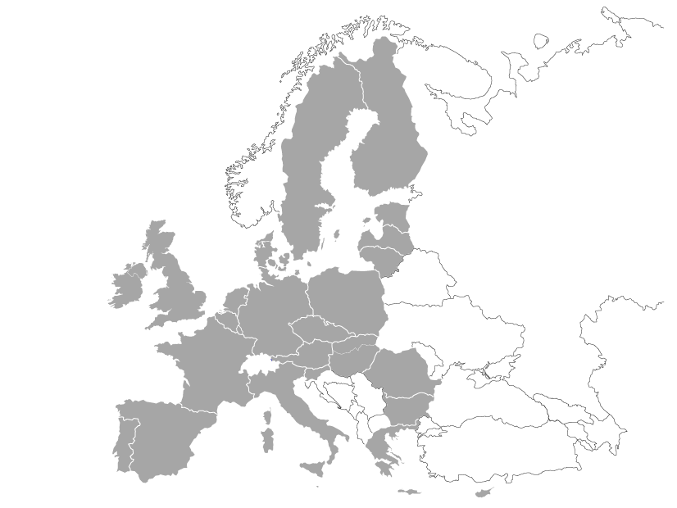
EU MS Digital Markets in 2010
“Too many barriers still block the free flow of online services and e-commerce across national borders. The Digital Agenda will update EU Single Market rules for the digital era. The aims are to boost … business, establish area for online payments, and further protect EU consumers in cyberspace”
FI
SE
EE
LV
DK
LT
IE
UK
NL
PL
BE
DE
CZ
LU
SK
AT
HU
FR
SI
RO
Digital Agenda for Europe
IT
BG
ES
EL

Slide 10
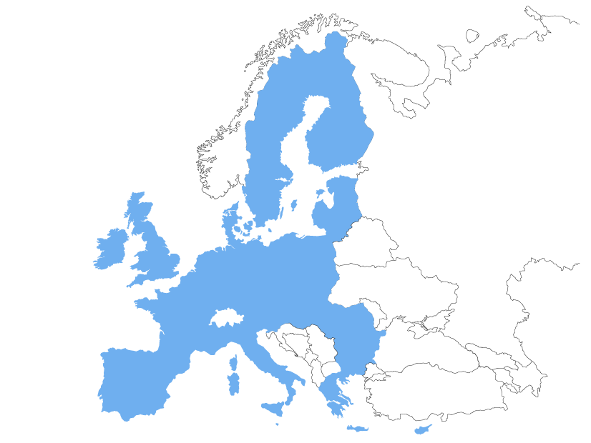
Harmonized Digital Marketspace in 2015
“Establish equal rules for the free movement of goods and services, both physically and digitally…
SE
FI
Ensure access of businesses and citizens to secure pan-European e-invoicing, e-payment, e-commerce and delivery systems and services…
EE
LV
DK
LT
IE
UK
BE
PL
NL
DE
Institute the regulation proposed by the Commission on electronic identification
and electronic trust services…
CZ
SK
FR
AT
HU
SL
RO
IT
BG
ES
EL
EU Parliament Report

Slide 11
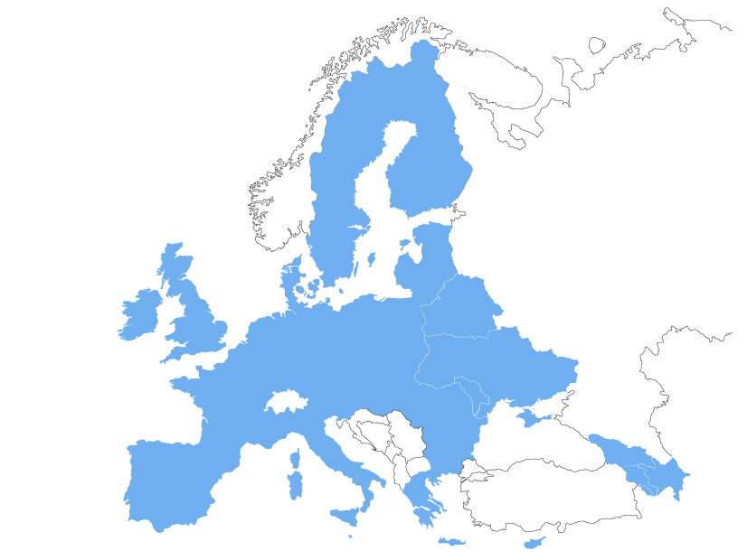










Pan-European Digital
Single Marketspace
HDM Initiative stands for convergence and integration of EU MS and EaP countries digital markets by means of multilateral cooperation projects to be implemented with MS and EaP countries involved
Harmonising Digital Markets
of EU and EaP countries
DigitalEurope CEO meeting

Slide 12

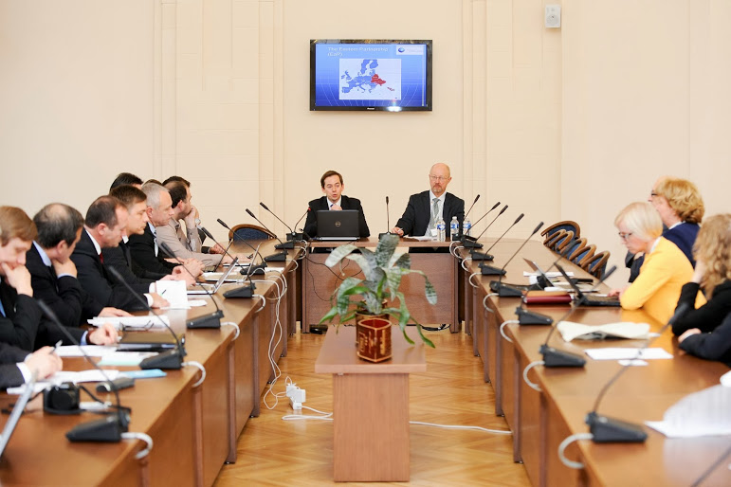

HDM Initiative Background
7th of Nov, 2013, Vilnius. “Shaping EU Digital Market” event session “Harmonizing of EU Digital market with Eastern Neighbours” event was held in Vilnius with participation of delegations from all EaP countries: Armenia, Azerbaijan, Belarus, Georgia, Moldova and Ukraine. HDM initiative was proposed by INFOPARK delegation.

Slide 13
CEE Digital Business Alliance
Digital Business Alliance (DBA) is to play the role of the main HDM projects coordinator in Central Eastern European (CEE) region and EaP countries.
DBA is to be founded as the Public Membership Institution and business union of the digital market experts, NTAs and service providers to consolidate consulting, marketing, project management and knowledge transfer expertise for the development of digital market infrastructure and services in CEE.
DBA is to unite the professionals and accumulate resources for implementation of inter-regional projects and programmes aiming at the development of harmonized digital marketspace in CEE countries.
www.infopark.by
www.infopark-association.org

Slide 14
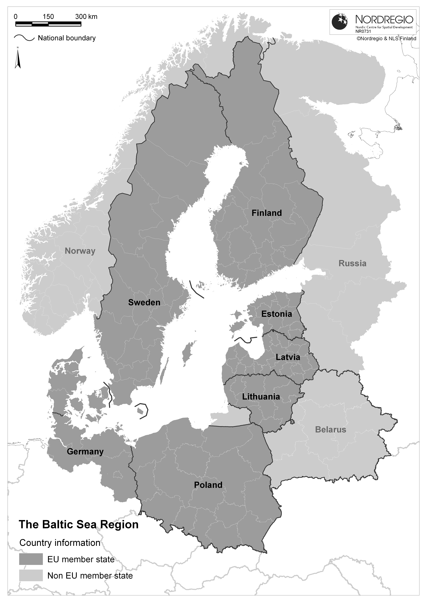
HDM Initiative.
Baltic Sea Region essential role.
Essential roles for HDM Initiative implementation are:
Baltic Sea Region countries cooperation and collaboration in the area;
Governmental support of HDM Initiative of Republic of Lithuania and Baltic Sea Region countries.
First implementation steps are to include National Digital Market Studies for Baltic Sea Region Countries.

Slide 15
HDM Initiative.
Developing the key project portfolio
The main topics to develop the key project portfolio were approved during the second Workshop on HDM Initiative in Brussels in October 2014:
E-Trade;
E-Custom;
E-Border Crossing;
Cross-Industry E-Invoicing etc.
www.infopark.by
www.infopark-association.org

Slide 16
Involvement to HMD Initiative
Proposals for bilateral Intergovernmental Commissions (Lithuania-Belarus);
Working out New Working Programme for Intergovernmental Agreement on ICT Cooperation (Lithuania-Belarus);
Incorporation of HDM Initiative Actions into “Intergovernmental Agreement on ICT the Republic of Lithuania and Republic of Belarus for 2015-16 years.
www.infopark.by
www.infopark-association.org

Slide 17
Contact information
Vladimir Basko,
Scientific and Technological Association Infopark
Director General
Chairman of HDM Working Group
12-55 Komsomolskaya Str., 220030, Minsk, Republic of Belarus
Tel./fax: (+375 17) 211-03-69
basko@infopark.by
http://www.infopark.by
Your questions are welcomed
The contents of this presentation are the sole responsibility of Infopark Association and can in no way be taken to reflect the views of the European Union.

