Slide 1

Securing the Cloud
Gintaras Pelenis
Field Technologist
RSA, the Security Division of EMC
Gintaras.pelenis@emc.com

Slide 2








No Shortage of Hard Security Challenges!
Extended
Workforce
Networked
Value
Chains
Sophisticated
Fraud
Mobile
Cloud
Big
Data
APTs
Infrastructure Transformation
Business
Transformation
Threat Landscape
Transformation
Less control over access device and back-end infrastructure
More hyper-extended,
more digital
Fundamentally
different tactics, more formidable than ever

Slide 3









Emergence of the Third Platform
BILLIONS
OF USERS
MILLIONS
OF APPS
3RD PLATFORM
2010
Mobile Cloud Big Data Social
Mobile Devices
HUNDREDS OF MILLIONS
OF USERS
2ND PLATFORM
TENS OF THOUSANDS
OF APPS
1990
LAN/Internet Client/Server
PC
MILLIONS
OF USERS
1ST PLATFORM
THOUSANDS
OF APPS
1970
Mainframe, Mini Computer
Terminals
Source: IDC, 2012

Slide 4






Emergence of New Attackers
Petty criminals
Organized crime
Criminals
Organized, sophisticated supply chains (PII, financial services, retail)
Unsophisticated
Nation state actors
PII, government, defense industrial base, IP rich organizations
Terrorists
Anti-establishment vigilantes
Non-state actors
PII, Government,
critical infrastructure
“Hacktivists”
Targets of opportunity

Slide 5
Evolving Attack Goals and Methods
Destructive
Attacks
Disruptive
Attacks
The
Unknown??
Sophisticated
Mobile
Attacks
Intrusive
Attacks
Advanced
DDoS
Hacker
Collaboration
Multi-Stage
Phishing
Pharming
APTs
Worms/
Viruses
Simple
DDoS
TIME
2007
2013
2020

Slide 6




http://www.emc.com/collateral/fraud-report/current-state-cybercrime-2013.pdf
As the world
goes mobile cyber crime will follow
1
TREND1 INTH3WILD

Slide 7
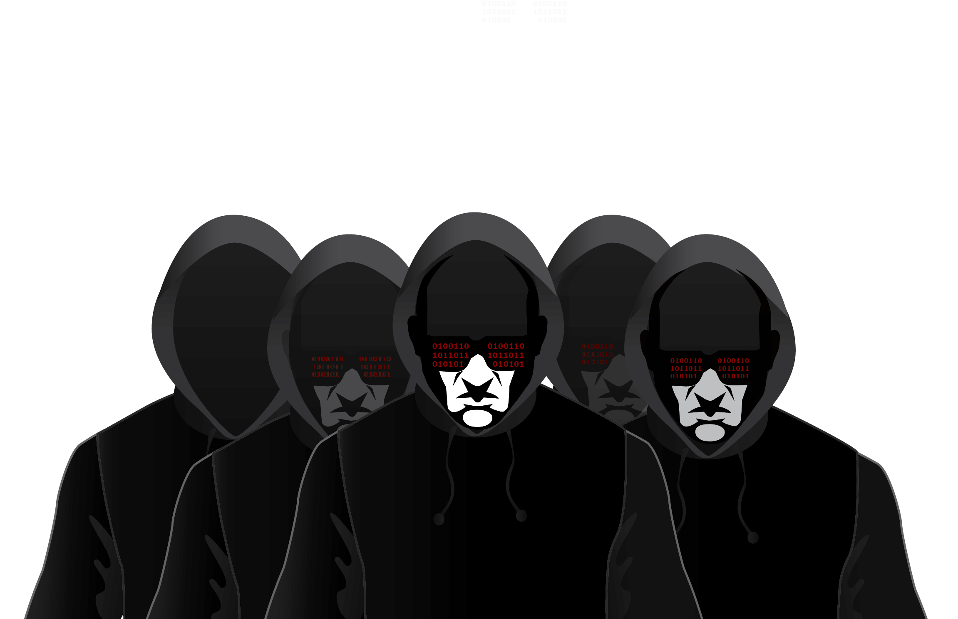
World wide
Trojans are going deeper underground
2
TREND2 INTH3WILD

Slide 8


Hacktivism
and the ever targeted enterprise
3
TREND3 INTH3WILD

Slide 9

Account takeover
and increasing use of manual assisted
cyber attacks
4
TREND4 INTH3WILD

Slide 10



Fraud-as-a-Service
Cybercriminals increase effectiveness of attacks - even leverage big data principles
5
TREND5 INTH3WILD

Slide 11


Traditional Security Is Not Working
97% of breaches led to compromise within “days” or less with 72% leading to data exfiltration in the same time
78% of breaches took “weeks” or more to discover
66% took “months or more”
Source: Verizon 2013 Data Breach Investigations Report

Slide 12
“…prevention and preventative security controls will fail. Prevention fails on a daily basis at many organizations; it will suffice to look at antivirus tools and contrast their 99%-plus deployment rates with widespread ongoing malware infection rates.”
Security Incident Response in the Age of APT, Dr. Anton Chuvakin, Gartner, September 25, 2013

Slide 13
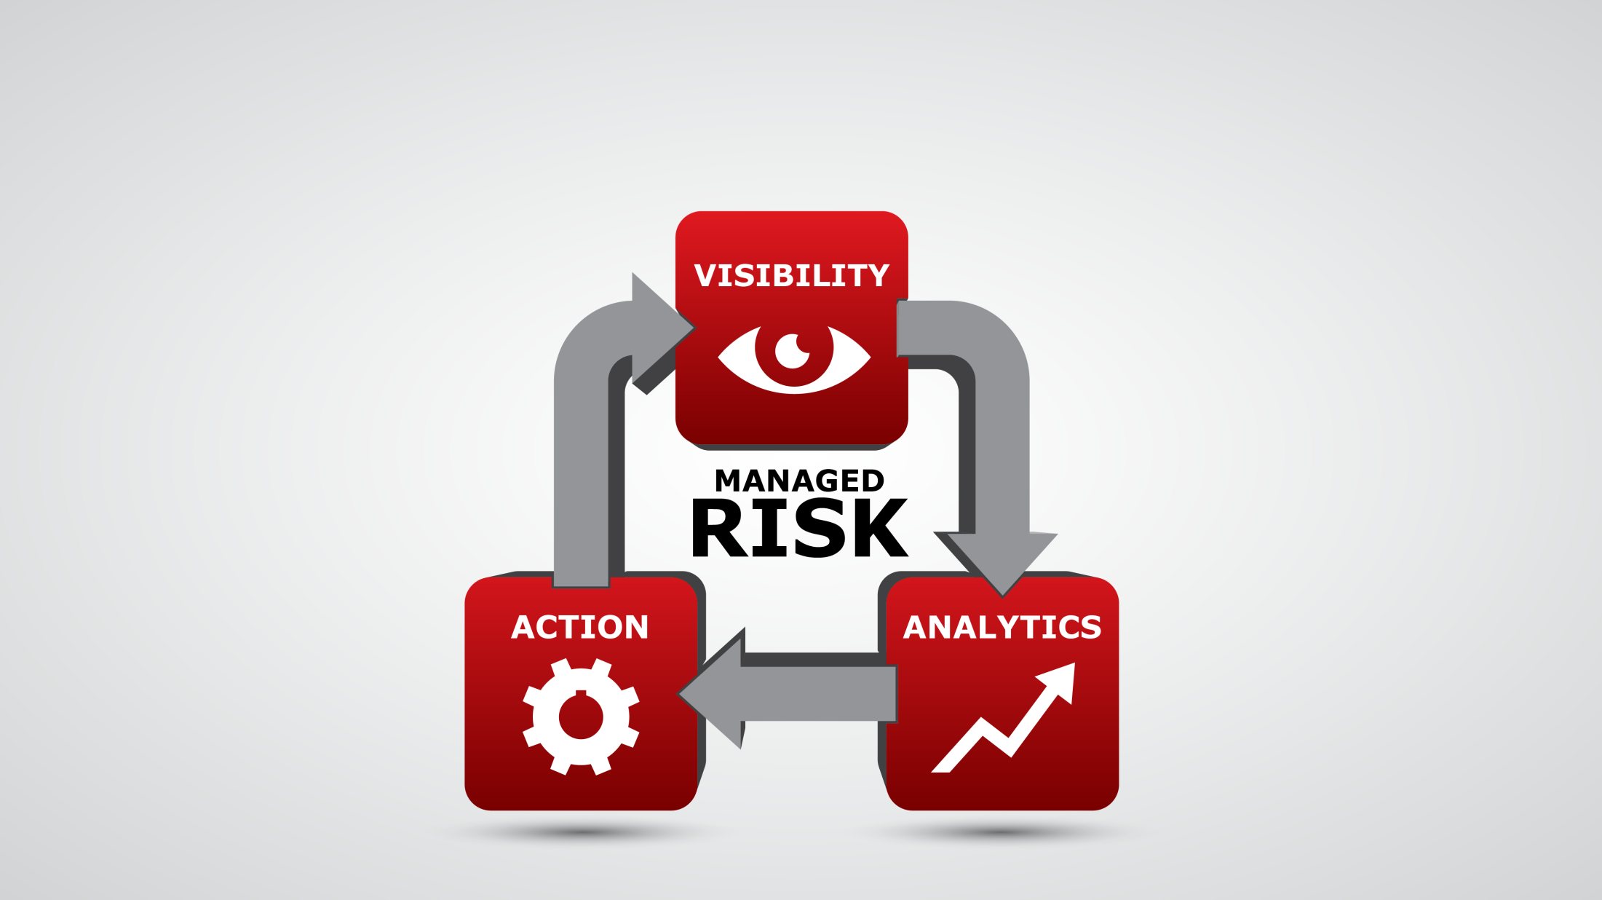
Intelligence is the Game Changer

Slide 14
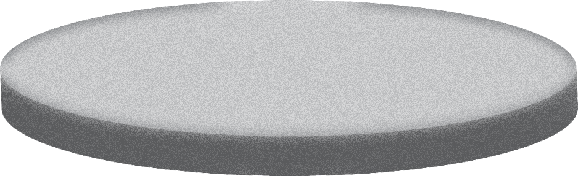
A New Security Approach Is Required
2ND PLATFORM
3RD PLATFORM
LAN/Internet Client/Server
PC
Mobile Cloud Big Data Social
Mobile Devices
IT CONTROLLED
PERIMETER-BOUND
PREVENTION
SIGNATURE-BASED
USER-CENTRIC
BORDERLESS
DETECTION
INTELLIGENCE-DRIVEN

Slide 15
Shift in Security Models
Reactive
Intelligence Driven
Historical
New
Perimeter-based
Static Controls
Siloed Management System
Risk-based
Dynamic/Agile Controls
Contextual/Interactive Management System

Slide 16






Achieving Intelligence-Driven Security
Critical Incident Response – process, people and technology
Tier 2 Analyst
Tier 1 Analyst
Analysis & Tools Support Analyst
Threat Intelligence Analyst
SOC Manager

Slide 17



Planning Your Journey
Siloed
compliance focus, disconnected risk, basic reporting
Managed
automated compliance, expanded risk focus, improved analysis/metrics
Advantaged
fully risk aware, exploit opportunity
Gain
resource & risk visibility
Identify
new business opportunities
Reduce
compliance cost
Manage
known & unknown risks
Compliance
Risk
Opportunity

Slide 18
Thank you

