Slide 1



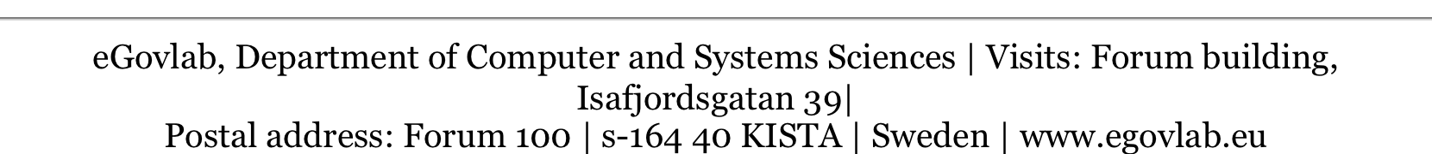
Public services… Reinvented!
Vasilis Koulolias,
Director

Slide 2

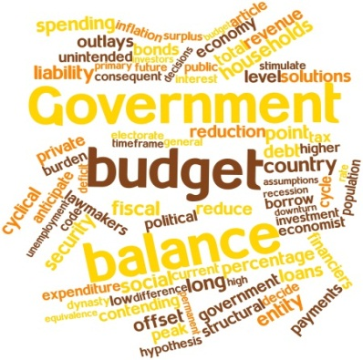


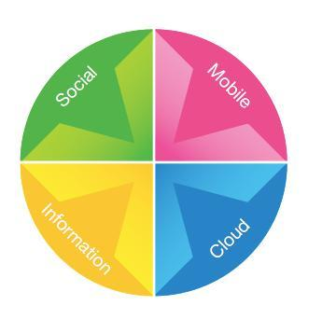
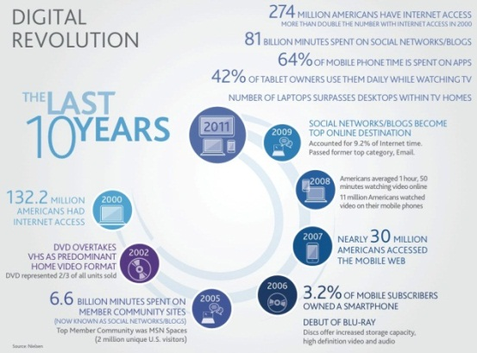
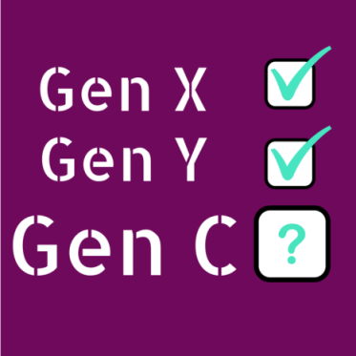
Context
Notes:
Thanks to technological transformation, we live in an environment which allows for increased (and easier) interaction between institutions, citizens and public and private organizations. This is particularly true for Generation-C (C stands for connection, creation, community), a demographic group where 65% is under 35,which is leading the way towards a "sharing society", characterized by blurred boundaries between collaborative production and consumption, that is likely to end up impacting the way public services are delivered.

Slide 3
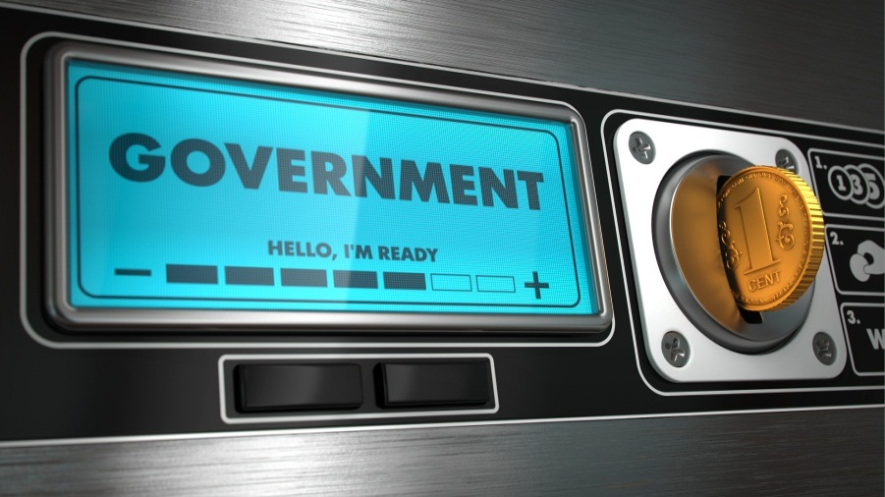
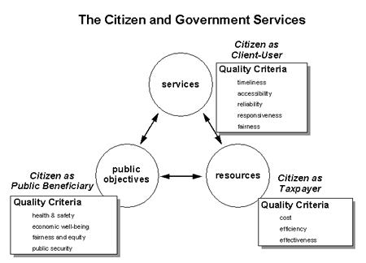

Government=vending machine?
Notes:
Donald Kettl: Vending Machine Government: Wepay our taxes, we expect services. When we do not get what we expect our "participation is limited to protest- esentially kicking the vending machine". Collective action has been watered down to collective complain.

Slide 4
Public Services for Public Value
Public Services: Services offered to the general public and/or in the public interest with the main purpose of developing "public value »
Public Value: The total societal value that cannot be monoplized by individuals, but is shared by all actors in society and is the outcome of all resource allocation decision
Notes:
As public services need to become more efficient and effective, governments have to consider innovative new ways of developing and organising the public sector for creating public value. Thus, transformation needs to address the way public value is created.
The future of government is less and less in the hands of governments alone. Technology has empowered ordinary citizens by offering them a way to make their voices heard and challenge government leaders about their ability and willingness to address public concerns and requests

Slide 5
Dynamics of Public Value
Authorize
Measure
Create
Authorisation is the process of answering the what question: What purpose does this service will fulfil?
Create is about answering the how question: What form of service delivery will meet public expectations and allow for continuous improvement?
PUBLIC VALUE
Measure is about answering the success question: How do we know if this service has achieved its objectives.

Slide 6
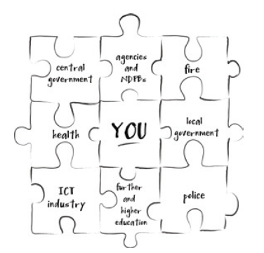
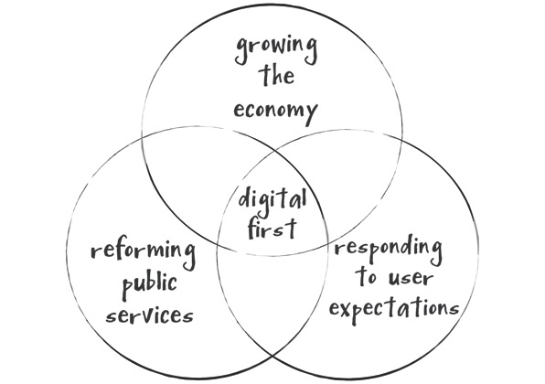
Citizen centric – digitaly enabled

Slide 7
…approach: Open and Collaborative Government
Open Data
Transparency
Collaboration
Open
Gov
Open Decisions
Open Services
Participation
Notes:
Engaging with the wider public can help meet the challenge of rising expectations. It will make the services more user-friendly and effective, improve the quality of decision-making, promote greater trust in public institutions and thus enhance public value [13].
This approach, driven by opening up and sharing assets - making data, services and decisions open - enables collaboration and increases bottom-up, participative forms of service design, production and delivery. The kind of public sector organisation that is at the heart of this transformation is open government, based on the principles of collaboration, transparency and participation and functioning within an open governance framework

Slide 8
… in context!

Slide 9
… a decentralized approach to public administration!
Main challenge is the coordination of public entities:
  67 independent agencies that run day to day operations
  290 municipalities + regional government

Slide 10
While there is pressure to:
  Improve IT management
  Increase IT maturity
  Increase capacities to run IT projects
  Produce strategies for IT provision
  Increase their capacities to deal with major change
  Improve the capacities to better assess how the agencies use public means

Slide 11
… private – public – research collaboration!

Slide 12
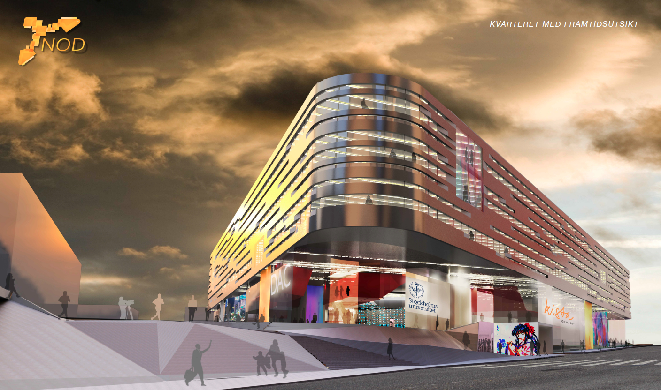
eGovlab & triple helix model

Slide 13
towardsnextprogrammecycle… eGovdolab
2015
Private Sector
Public Sector
2015
eGovlab
2014
67 agencies
290 municipalities
21 counties
Research & Academia

Slide 14
Co-production….life-cycle
Public/Private/RD/Citizens
Assigned to R&D
step3
Concept co-creation
eGovlab PM
Requirements
presentation
step1
PM Coordination
design
Sign off phases
Administration
Legal
Financial
step2
RFP
development
preliminary
analysis
step4
PROJECT MANAGER
proposal
Acceptance
acceptance
DIRECTOR
Citizen Consultations

Slide 15
… the challenge!

Slide 16
…key elements of the digital agenda are:
  to Simplify public services
  to Open up public services
  to Increase public service efficiency

Slide 17
Goals of the Government
World class public service built on digital opportunities
Easier/simpler every day life for the citizens
Open governance that supports innovation and citizen participation
Better quality and efficiency in governance

Slide 18
… based on life events!

Slide 19
Such as:
  Moving to a new home or building one…
  Getting a drivers license or buying a car…
  Going to school…
  Starting a company…
  Running a company…
  Losing and finding a job…
  Engaging in legal procedures…
Notes:
.

Slide 20
This requires a joint effort towards digital services
Smarter e-services and apps
Enabling a triple helix model
More support to governmental agencies
Better control and follow up
Cooperation with the municipalities

Slide 22
Thank you for your attention!
Vasilis Koulolias,
Director
eGovlab
vasilis@egovlab.se

