Slide 1

Expectations and fears of the governments towards the cloud computing
Hannes Astok
Deputy Director
eGovernance Academy
Former Member of the Estonian Parliament

Slide 2
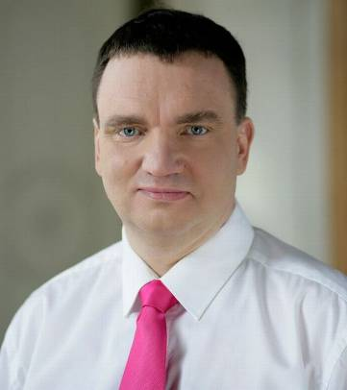
Hannes Astok
2011 - eGovernment expert, Deputy Director, e-Governance Academy
2007-2011 – Member of the Estonian Parliament
2005 - Programme Director, municipal and regional eGovernance, e-Governance Academy
1998-2005 Deputy Mayor, Tartu City Government

Slide 3
What is E-Governance Academy?
eGovernance Academy is a non-profit organisation for the creation and transfer of knowledge concerning e-governance.
Activities
Research & Analysis
Training
Consultancy
Programs
Central government program
eDemocracy program
Municipal eGovernance program
Learn more: www.ega.ee

Slide 4
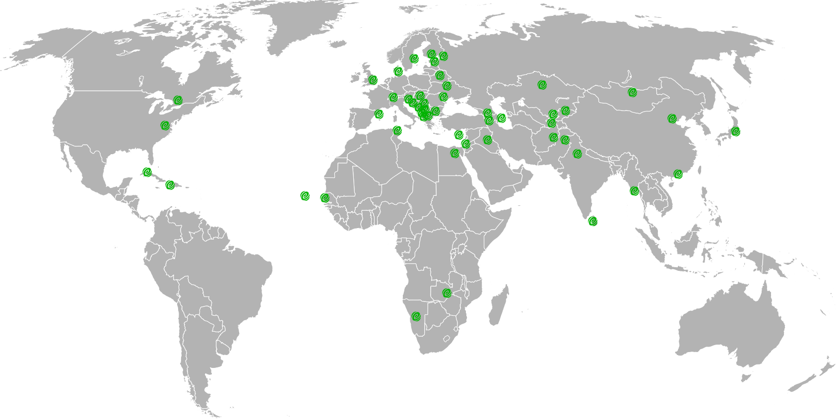
COOPERATION WITH MORE THAN 40 COUNTRIES

Slide 5
TYPES OF CLOUD COMPUTING

Slide 6
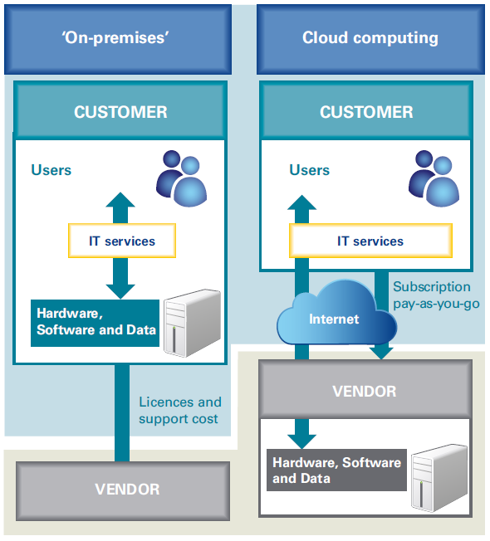
Traditional services vs Cloud

Slide 7
Types of cloud services
Private cloud
Public cloud
Community cloud
Hybrid cloud

Slide 8
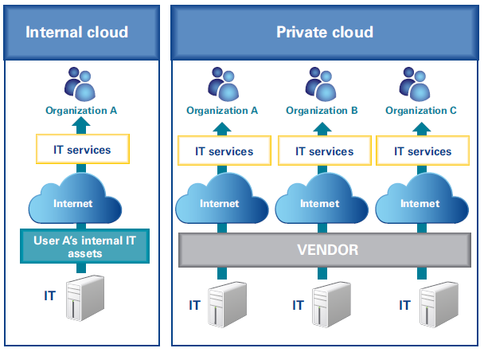
Private cloud

Slide 9
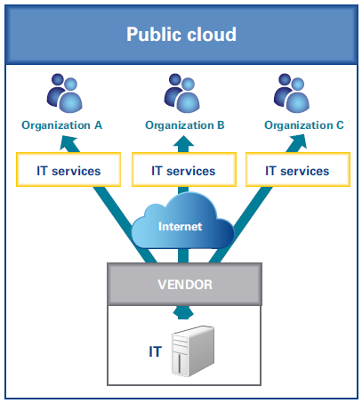
Public cloud

Slide 10
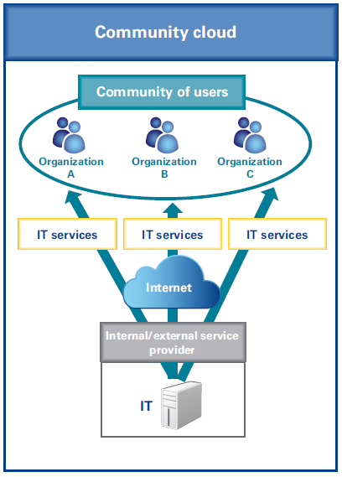
Community cloud

Slide 11
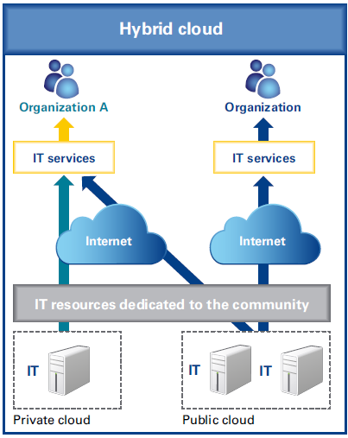
Hybrid cloud

Slide 12
Cloud service models
Infrastructure as a Service (IaaS)
Platform as a Service (PaaS)
Software as a Service (SaaS)

Slide 13
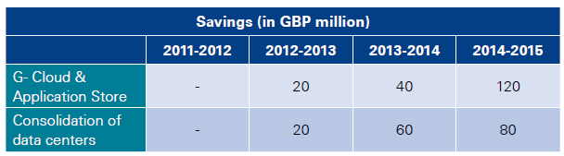
Benefits of the cloud services
ICT infrastructure
  Investments
  Procurement
  Running and maintenace
Flexibility
Scalability
UK Government estimated savings, 2011

Slide 14
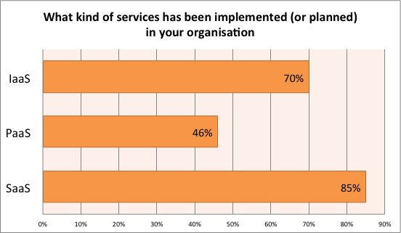
Already implemented services deployment models for governmental Clouds in Europe
ENISA 2011

Slide 15
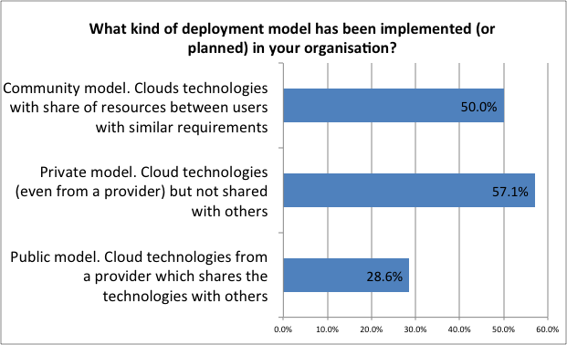
Already implemented cloud models for governmental Clouds in Europe
ENISA 2011

Slide 16
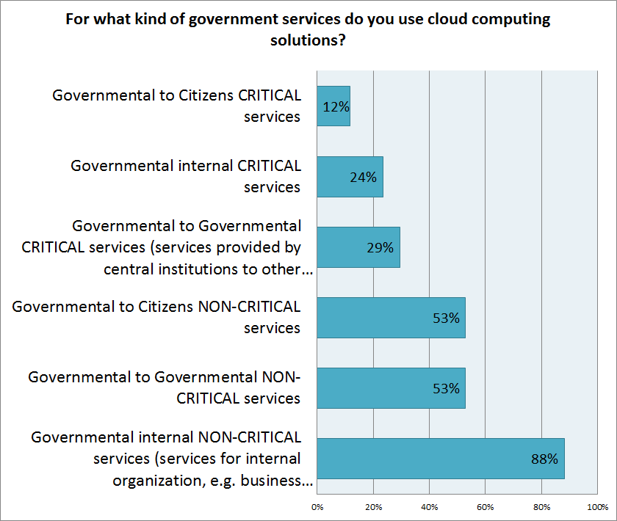
Type of government services in cloud
ENISA 2011

Slide 17
CHALLENEGS FOR THE GOVERNMENTS

Slide 18
Lack of experience
  Contracts
  Vendor selection and certification
  Data migration
  Ending contracts/changing vendors
Data security
Data integrity
The different national laws
Internet connection stability and speed

Slide 19
WHAT
NEXT?

Slide 20
Future scenarios
Public cloud services for non-critical and public data
Government clouds (private of community cloud models)

Slide 21
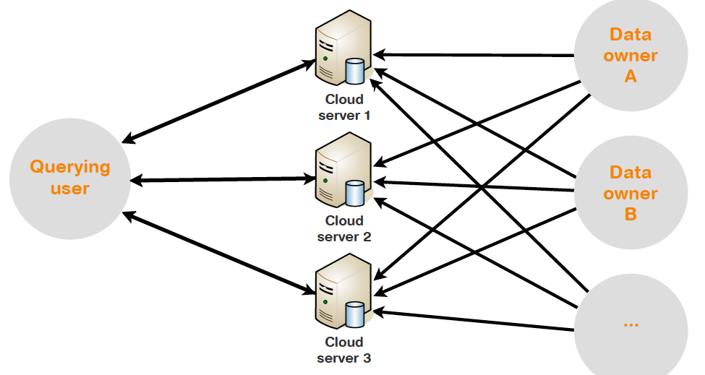

CRYPTOGRAPHY AND DATA SPLITTING
Encrypting all data
Splitting data between clouds
Learn more:
https://sharemind.cyber.ee/

Slide 22
DATA EMBASSIES
Storage of the data in other countries in the Embassies (it is territory of the country)
Disaster recovery copies of the government databases: to save the country in case of emergency (natural disasters, others)
VIDEO

Slide 23
NEXT STEP FROM DATA EMBASSIES
Bilateral cooperation between the countries to store the data
Agreements NOT to spy ☺

Slide 24
CITIZENS
IN CLOUD?
ESTONIAN
E-RESIDENT!

Slide 25
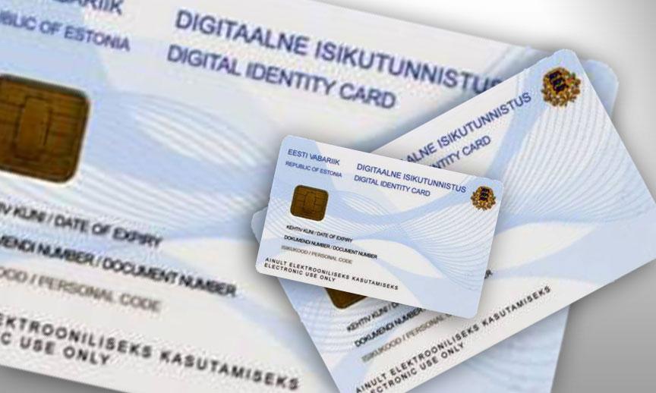
E-resident = non-resident person with Estonian digital identity (smart ID card)
Works like Estonian ID-card, but no photo: meant only for access to digital services
Govt-as-start-up: going live with beta, constant iteration/enhancement from there

Slide 26

10 MLN E-ESTONIANS BY 2025!

Slide 27
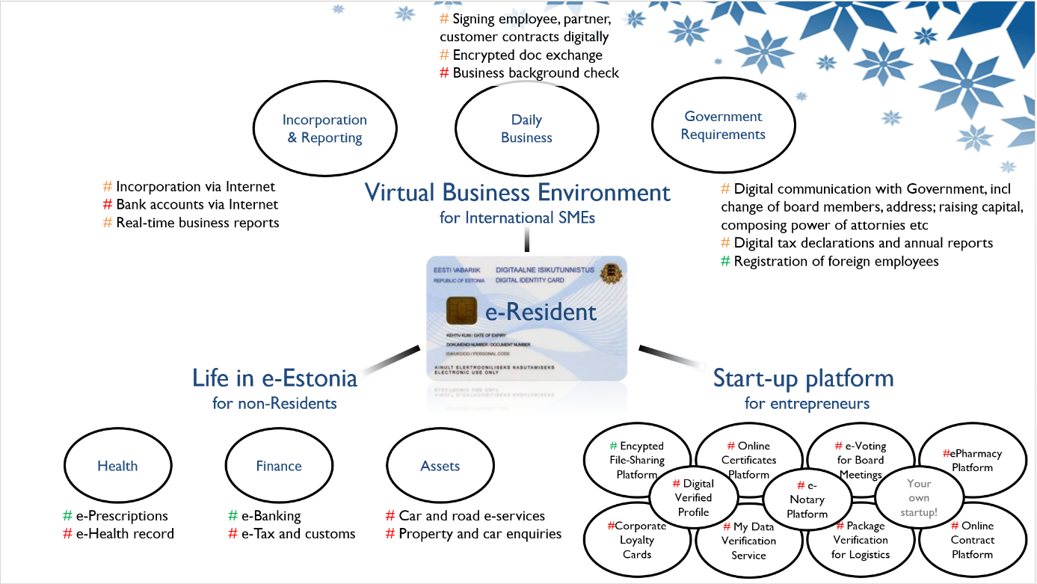
Services (in development)

Slide 28
HOW TO GET E-RESIDENCY?
Stage 1: issued in EE only (Police & Border Guard), since 1 December 2014
Stage 2: EE embassies abroad will also issue, by summer of 2015
Person comes in person, gives biometrics and shows own national ID
Max. 2 weeks of processing
50 EUR one-time fee (incl. card reader)
Work on the way to add Mobile-ID in the batch

Slide 29

Sign up to notification list:
www.e-estonia.com/e-residents

Slide 30


Estonia

Slide 31

Thank You!
Hannes Astok
www.ega.ee | hannes.astok@ega.ee| +372 50 91366
E-Governance Academy | Tõnismägi 2, 10112 Tallinn, Estonia

