Slide 1
Real world cloud computing challenges
Giedrius Markevičius
Territory account manager

Slide 2
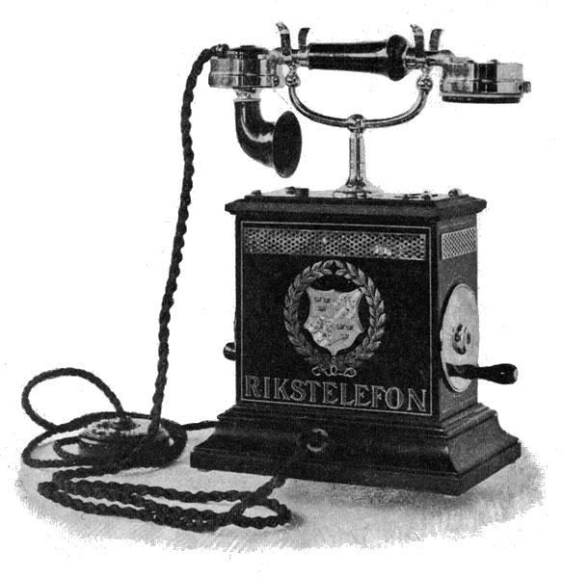
Past
“Well informed people know it is impossible to transmit the voice over wires, and if it was possible, the thing would be of no practical value.” – Boston Post, 1865

Slide 3

Today
“Active Mobile phone users in Lithuania,
2014 Q2
4.486.764
www.rrt.Llt

Slide 4

Today
“Active Mobile internet users in Lithuania,
2014 Q2
1.967.800

Slide 5






Today
“Internet users total in Lithuania,
% of population 2013
73%

Slide 6
Today
“Newspapers readers in Lithuania,
% of population 2013
53%
www.tns.Llt

Slide 7

Today
“Social Media users in Lithuania,
% of population 2013
46%
www.tns.Llt

Slide 8


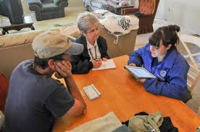
REACH
MOBILITY IS A
GROWING DEMAND
PUBLIC EXPECTATION
IS ON THE INCREASE
of public sector employees
want to access their
apps and data from
mobile devices
Citizens expect government
employees to have access to
government applications and information, whether or not
they are behind a desk
89
%
“Emerging Strategies for Managing Mobility,” 1105
Government Information Group, September 2013
Notes:
Uncontrolled Mobility & Diversity
89% of workers say a mobile device makes them more productive yet only 1 in 5 agencies have an official BYOD policy. Workers are using blurring the lines between work and personal devices, using them often interchangeably without official policy, compromising security.
Interagency Collaboration
Increasing numbers of agencies and sub-agencies, each with their own technology silos that both need to be protected and need to be available as needed for collaboration and better citizen service.

Slide 9


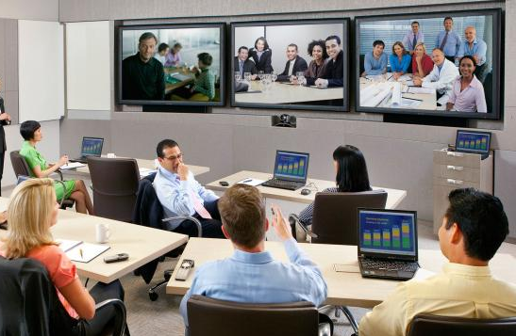
RESPOND
ACCESSABILITY
IS A CRITICAL REQUIREMENT
COLLABORATION
IS A GROWING EXPECTATION
Quick access to critical applications and information is essential to the government being able to
save time, money and lives.
“Annual Reporting to increase Interagency Collaboration and Coordination” IS NOW A LAW for Health and Human Services.
Health Reform Act of 2006
Notes:
Uncontrolled Mobility & Diversity
89% of workers say a mobile device makes them more productive yet only 1 in 5 agencies have an official BYOD policy. Workers are using blurring the lines between work and personal devices, using them often interchangeably without official policy, compromising security.
Interagency Collaboration
Increasing numbers of agencies and sub-agencies, each with their own technology silos that both need to be protected and need to be available as needed for collaboration and better citizen service.

Slide 10


SECURE
CYBERCRIME can threaten the security of citizen
data, disrupt operations and endanger public safety
“Public sector employees WILL DO WHAT IT TAKES, Including circumventing onerous security procedures, to do their jobs”
50%
Of cybercrime incidents
target government services
“Emerging Strategies for Managing Mobility,” 1105 Government Information Group, September 2013
Notes:
Uncontrolled Mobility & Diversity
89% of workers say a mobile device makes them more productive yet only 1 in 5 agencies have an official BYOD policy. Workers are using blurring the lines between work and personal devices, using them often interchangeably without official policy, compromising security.
Interagency Collaboration
Increasing numbers of agencies and sub-agencies, each with their own technology silos that both need to be protected and need to be available as needed for collaboration and better citizen service.

Slide 11





Mobile-cloud Era
- The CIO paradox
New expectations…
Create competitive advantage
New products & services
… and the prior responsibilities
Run global infrastructure
Support business-critical
applications
Be strategic
Stay secure
Quickly adopt
technology
Avoid legacy
debt
Boost
innovation
Drive operational
excellence
Notes:
Point – easy to say IT now in innovation and digitization business. Not necessarily easy to do.
While CIO needs to be strategic – also drive operational excellence
Story – MD into tech, took role as CIO big hospital group, leverage his medical knowledge – 1st week on job major DC outage
Quickly adopt technology - but also need to have rational architecture and standards to minimize TCO
Story – Met with VP Operations major bank recently – described it as “14 datacenters full of at least 1 of every infrastructure product made in last 10 years”
Boost Innovation. Use latest and greatest keep up with competitors and changing needs of consumers. Chinese army still hacking at your network.
Boost innovation – but avoid security and compliance issues that arise from mish mash of haphazzard technologies
Point – IT role has to expand. Role can no longer be limited to implementing and maintains systems. BUT – cant give up that role.
AND not OR function
???
Note – interesting Target CEO fired for breach under his watch
Kathleen sebelius – HSS – basically took fall for website launch failure
Free market – done what Sarbanes Oxley never achieved.
Hold Executive accountable for Tech compliance

Slide 12

Customers expectations
IT Technology Eras
Mainframe
Client-Server
Mobile-Cloud
Millions of Apps
Billions of Users
Business Expectations
Ability of IT to Deliver
Steady IT Budgets*
$ $ $ $ $ $
* Source: Gartner, 2013: “Hunting and Harvesting in a Digital World: The 2013 CIO Agenda”
Notes:
Summarize problem space – then move to solution space
Budgets are flat
With Ongoing focus on cost reduction and efficiency – IT’s ability to deliver goes up a bit over time.
But not fast enough.
Business expectations going exponential.
Need to become strategic partner and “make IT happen” without long planning cycles to deliver speed in mobile cloud era.
Still need to focus on blocking and tackling - business critical system maintenance, support, security, compliance.

Slide 13




Reality Bites
Budget issues
Budgets flat/declining (proportionally)
Need to spend more on innovation versus support
Skills / People / Experience
In short supply
Accelerating pace of new technology
Legacy systems
Complex and rigid
Legacy process
Siloed
Not standardized
… Your Real Problem?
Notes:
Not just problem of two masters.
Challenge - budgets not rising with user and LOB expectations.
You Need to - carve bigger piece of same pie to fund cloud-era innovation.
New analyst research shows that ‘Skills gap” is rising up CIO list of top concerns.
You need to – find solution that allows you to use and modify existing personnel
Q: How many of you think there is a pool of available Python or node.js developers in your city?
People want a button to push. Not want to fill out a service request or talk to help desk.
You need to - Reduce friction – way business interacts with IT.
Your path to killer software – its an IT project. How many handoffs. How many meetings?
Need to give IT staff and developers their own button – give them what they want when they want it.
Legacy system- Uber not have complex existing legacy back end to deal with.
Takes more time to add field to enterprise Marketing system integrated with salesforce.com – than takes to write Uber app from scratch.
I’m from silicon valley - joke at cloud meet up by VC funded startups with no revenue – “your problem, is you already have a successful business you have to design around”…
Story - DevOps conference recently –someone from eBay presented – said it took something like 150 IT tickets to deploy a new system.
Story – VMware IT – call it human middleware. 40 times a year - Dev needs new instance Oracle ERP – deployed with our custom Customer Portal – load balancers etc.
Call IT. IT reply – “lets schedule a planning meeting…” 6 weeks – 40 man weeks of work.
Then dev spend another week debugging before can start development project.
We’ve replaced human middleware – now click button, 27 hours, 80 different application components.
Goal 24 – 18 provision, 6 integration and functional testing
People don’t believe us until we show them. Full oracle ERP, full custom web portal, integration, load balancers, web servers, integration testing, functional testing. 27 hours.
Talk about innovation. Developers now ask for a Dev instance – “want to try something” never would ask before.
IT never says no.
Developers never have to debug to start work.
Really game changer

Slide 14
?
What are your strategic
Options
Notes:
Ok – You need both. Business speed and agility. Also need maintain control and efficiency.
In fact – in mobile cloud era – even more important for IT to maintain control than in previous era.
What are your options?

Slide 15







New IT Agenda
Provide Access To
All Applications & Data Through
Mobile Devices.
2
Use Agile Development To
Build New Customer-Centric
Applications.
Build A Data Lake To Deliver
Greater Insight In Real Time.
Move To A Software-Defined
Data Center Infrastructure and Expand It To a Hybrid Cloud.
Use Adaptive, Data-Driven Security To Rapidly Respond To
Emerging Threats.
Notes:
At the same time, there is an opportunity and real need for IT to understand these new web and mobile platforms and partner with the business to build new capabilities so that your company can be the disruptor, not the disrupted.
But, with all change, it must come without creating undue risk in any system. Security threats are growing and it’s not enough to just guard the castle walls any more. The bad guys are inside, and you have to find them before they get out with your assets.
<CLICK>
All of this is leading to a new IT agenda. An IT agenda that will reduce costs, increase speed for new growth and balance risk.
First, by building a completely virtualized and automated Software-Defined Data Center, you will lower the cost of running IT and provide the foundation for faster, more agile IT. This Software-Defined Data Center provides a seamless cloud environment that can be extended from private cloud to the public cloud, forming a secure hybrid cloud – removing barriers to providing self-service and the highest service levels ever.
Next, you will need to build new applications in an agile way, with new platforms and target those applications at mobile devices. Those mobile devices all managed by IT to secure your corporate information, while driving employee productivity and satisfaction. As you start to store and analyze the massive data sets that are available, you will gain new insights about your customers and your business. This requires a “Data Lake” to store these vast amounts of information, and provide the ability to analyze and correlate it.
Finally, an adaptive, data-driven approach to security that watches and analyzes all activity so that you can quickly recognize the anomalies and act before it’s too late.

Slide 16
Re-Defining IT
3
  Become Operationally
  Agile
2
  Start Enabling
  Technology Journeys
  Develop Integrated Operating Model Changes
1
✓
  Develop
  Transformation Strategy
  Design Technical Roadmaps
  & Execute On Each Journey
    People Skills & Mindset
✓
    Processes
  End User Computing
✓
  Identify The Right Strategy For Your Enterprise
    Organization
  Applications
✓
    Reduce Cost Then Innovate
Data
✓
    Fix Core And Innovate
Infrastructure
✓
    Innovate Immediately
Security
Notes:
We've talked about technology, it's not just about technology. Also need strategy and operating model. Then our consulting or partner consulting.

Slide 17

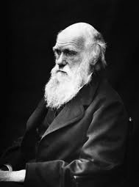
It is not the strongest
of the species that
survives, nor the most
intelligent that survives.
It is the one that is
the most adaptable
to change.
Charles Darwin

Slide 18
Dėkoju!

