Slide 1
Selected trends and some insights in prevention
Vilnius, 12 November 2014
Roland Simon

Slide 2
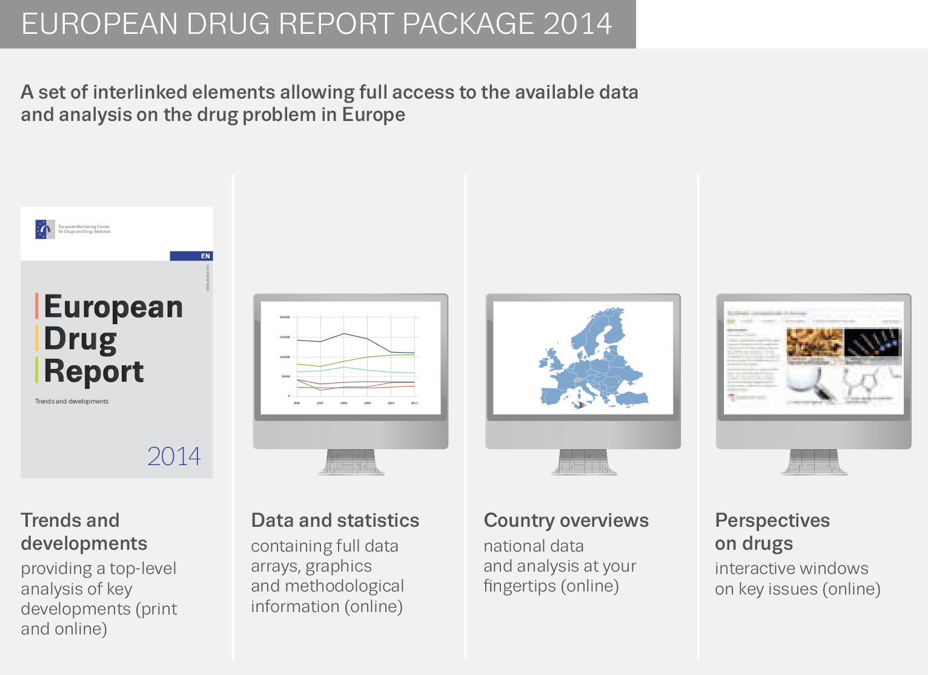
European Drug Report (EDR) package

Slide 3
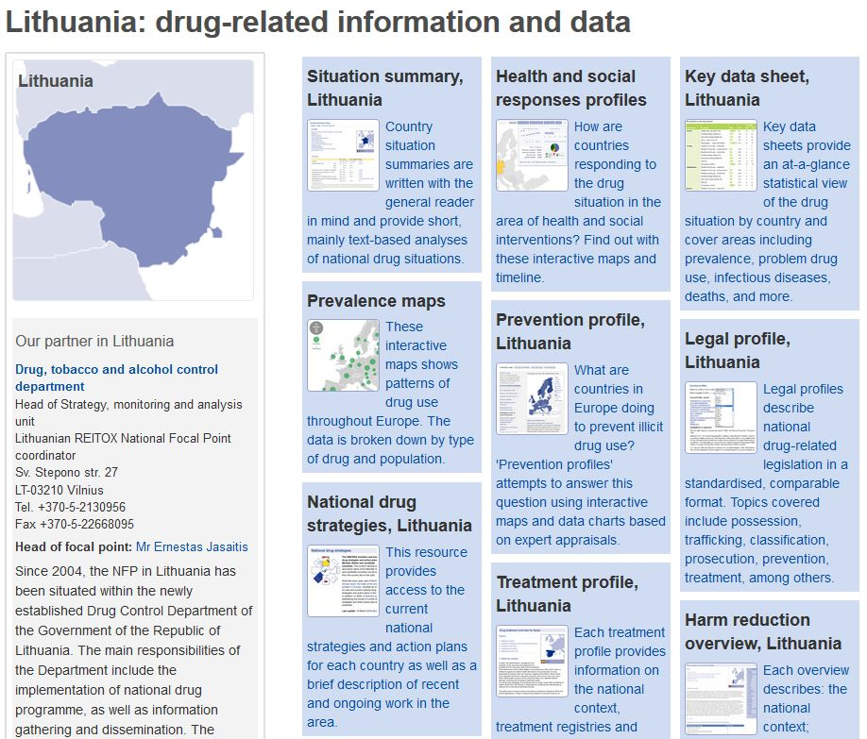
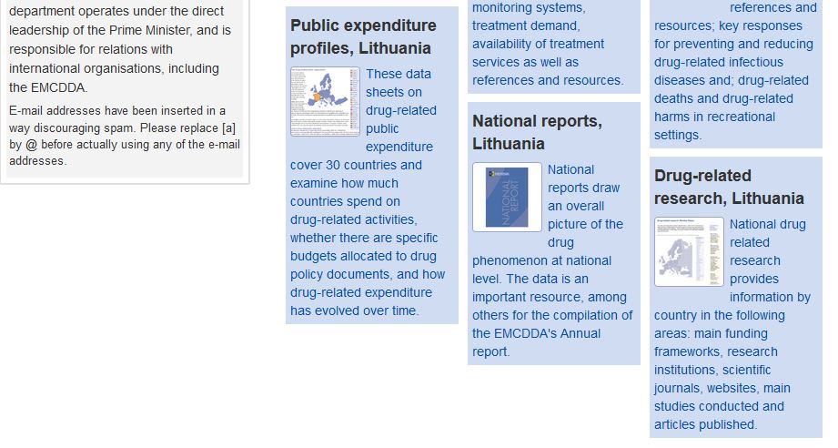
EDR: country overviews

Slide 4
Main topics
State and trends
- Cannabis
- Stimulants
- Other drugs
Prevention

Slide 5
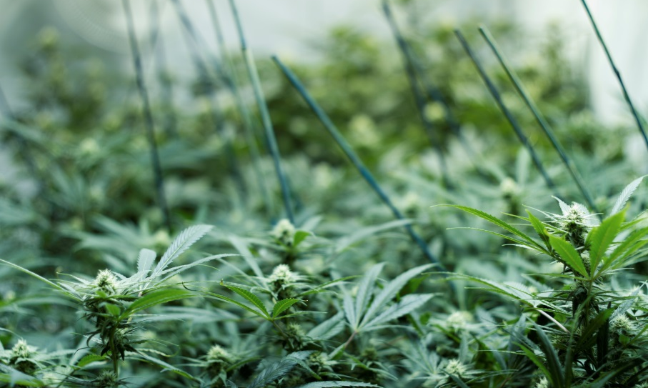
Cannabis

Slide 6
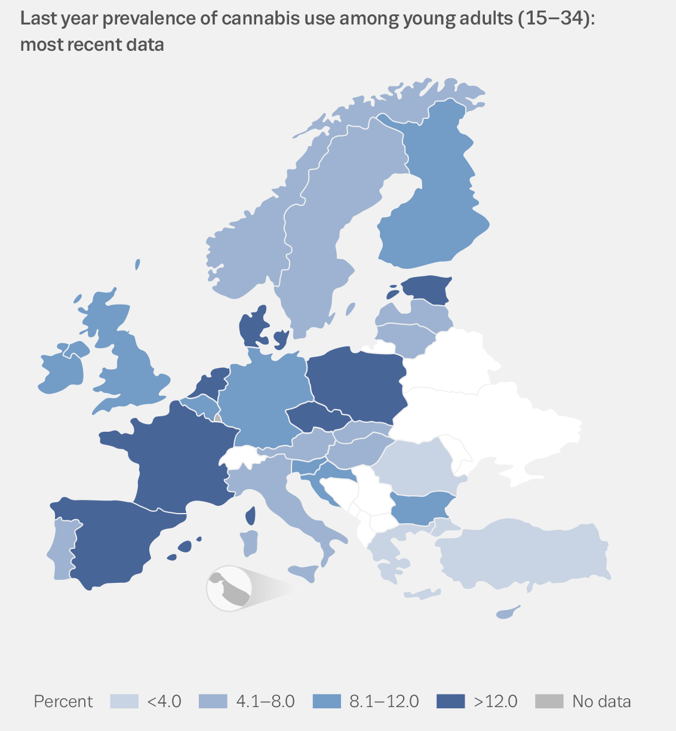
Cannabis: Europe’s most commonly used drug
  73.6 million adults ever used cannabis
  14.6 million young adults used last year

Slide 7
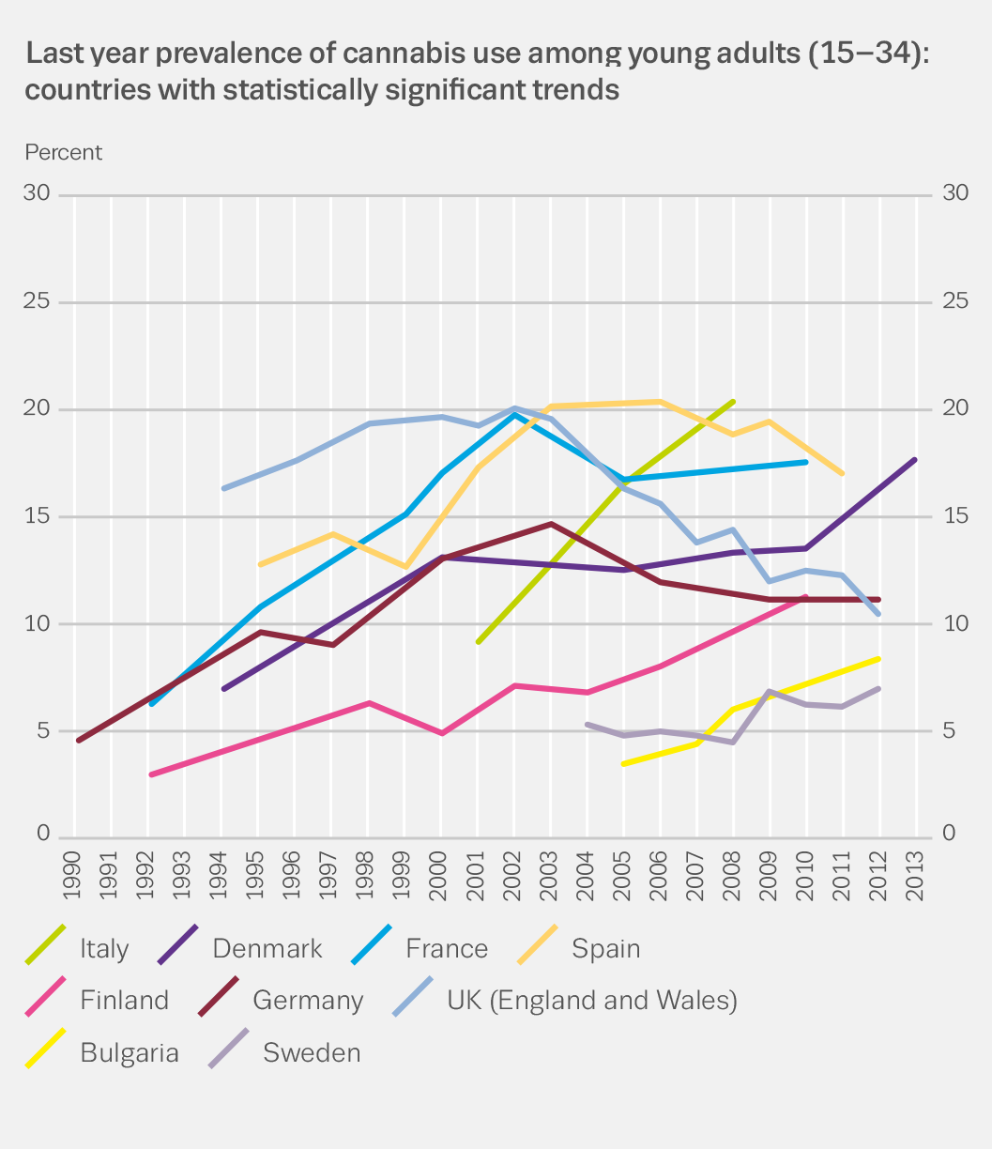
Cannabis: divergent national trends
  9 countries — statistically
  significant trend
  Regional patterns observable
  Latest surveys — divergence
  continues

Slide 8
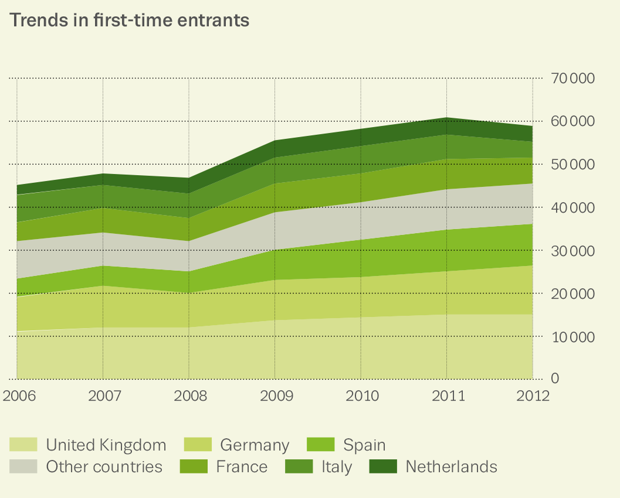
Cannabis-related problems continue
  Most frequently
  reported drug by
  new treatment entrants
  Almost 1% of adults
  daily users

Slide 9
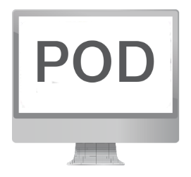
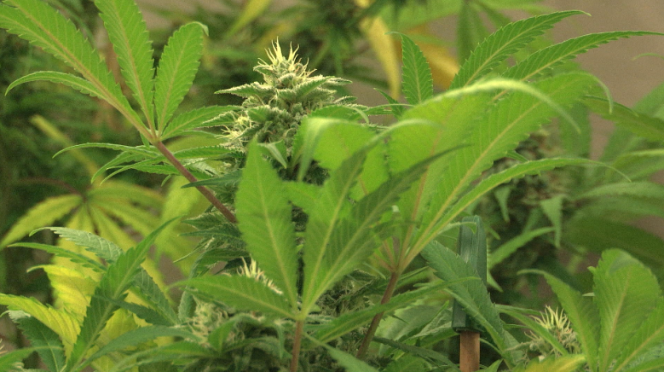
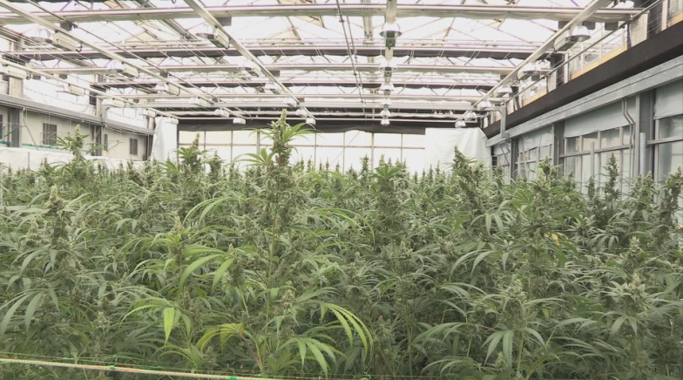
Cannabis supply
  Domestic production up
  Cultivation of
  plants high in THC
  Potency increases for
  herb and recently resin

Slide 10
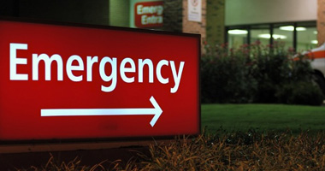
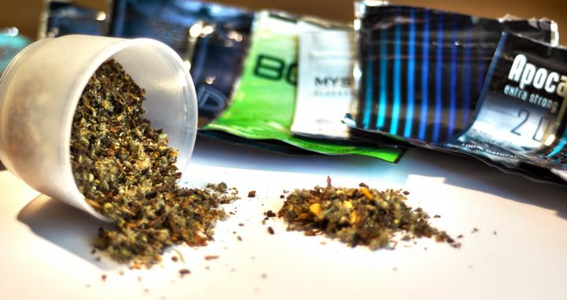
Acute emergencies for cannabinoids rare, but increasing
  Cannabis-related emergencies — a growing problem in high-prevalence countries
  Synthetic cannabinoids —
  new dimension
  Use limited, but can be highly potent

Slide 11
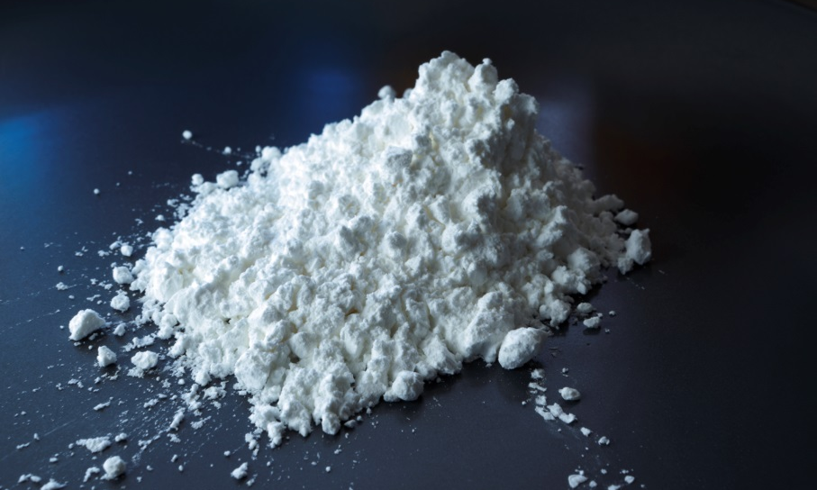
Stimulants

Slide 12
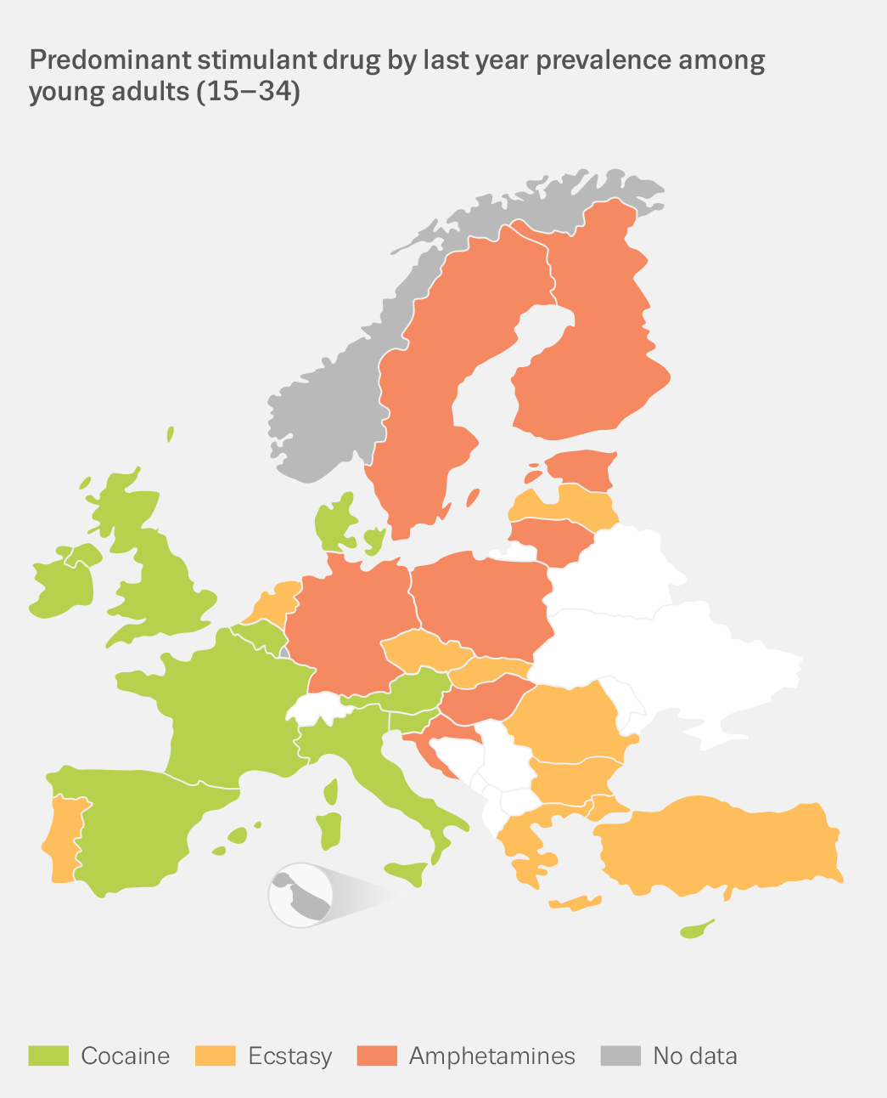
A geographically divided stimulant market
2.2 million Europeans
(15–34 years old) used cocaine in the last year
1.2 million used amphetamines
1.3 million used ecstasy

Slide 13
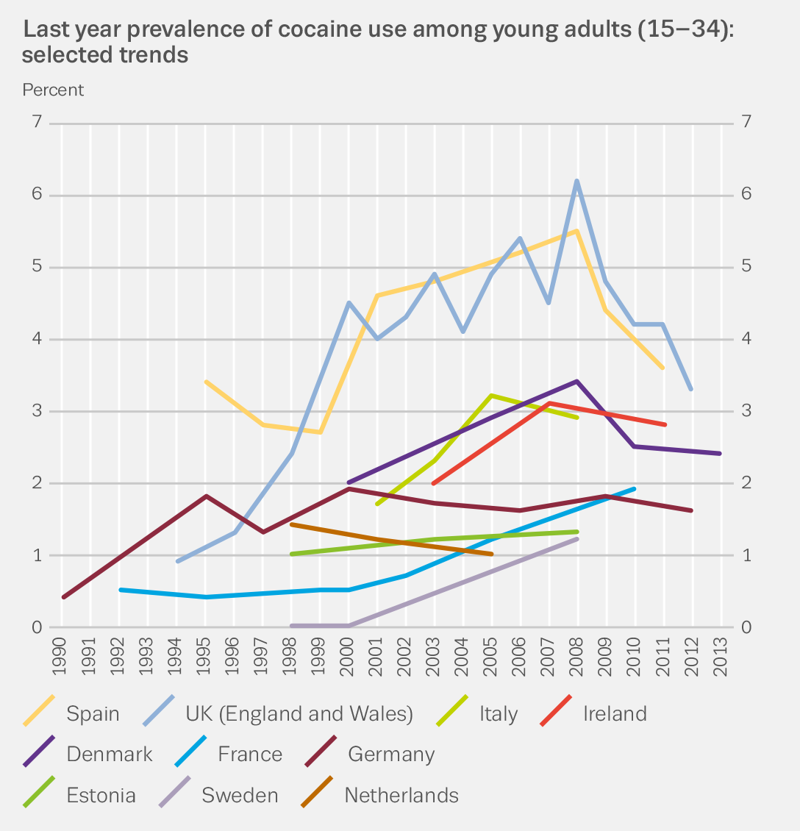
Cocaine: continued signs of decline
  Most commonly
  used stimulant, but…
  Declines seen for higher prevalence countries
  And in 11 of 12 new surveys

Slide 14
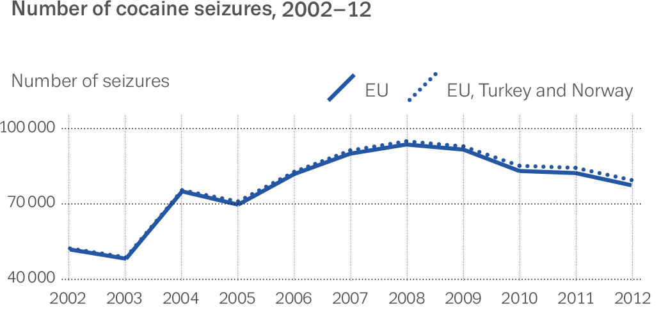
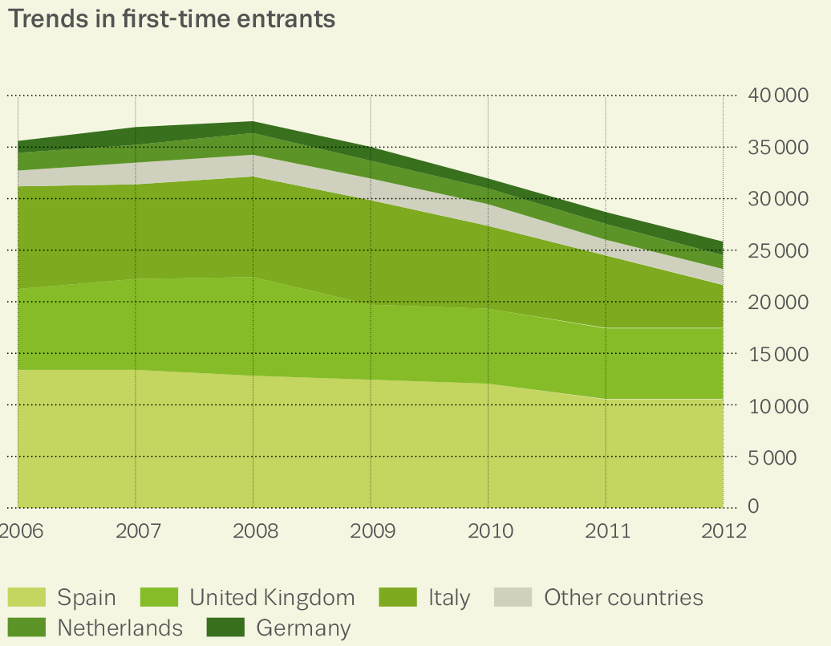
Cocaine: continued signs of decline
Seizures decline
from 2008
Decrease for first-time treatment entrants

Slide 15
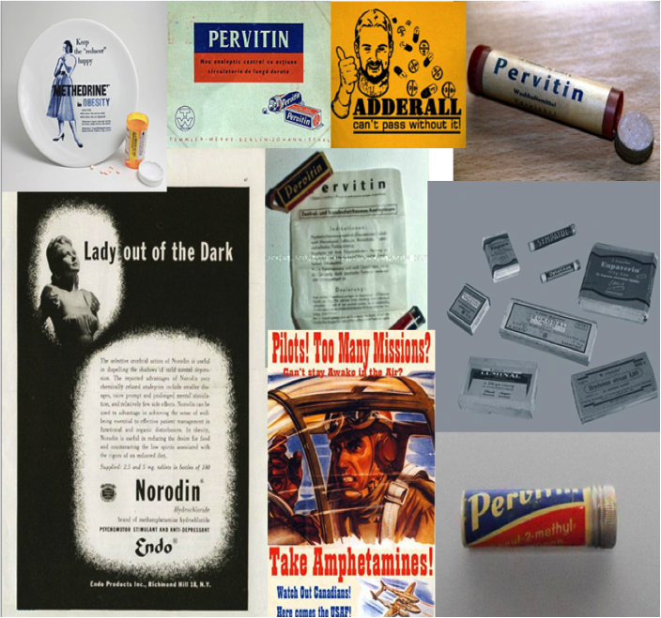
Further developments
Methamphetamines
CZ and SK: longer term entrenched patterns of use, but treatment up
CZ/DE: cross border markets
North: interlinked with amphetamine
New psychoactive Substances
more new compounds reported every year, but overall small market size in most countries

Slide 16
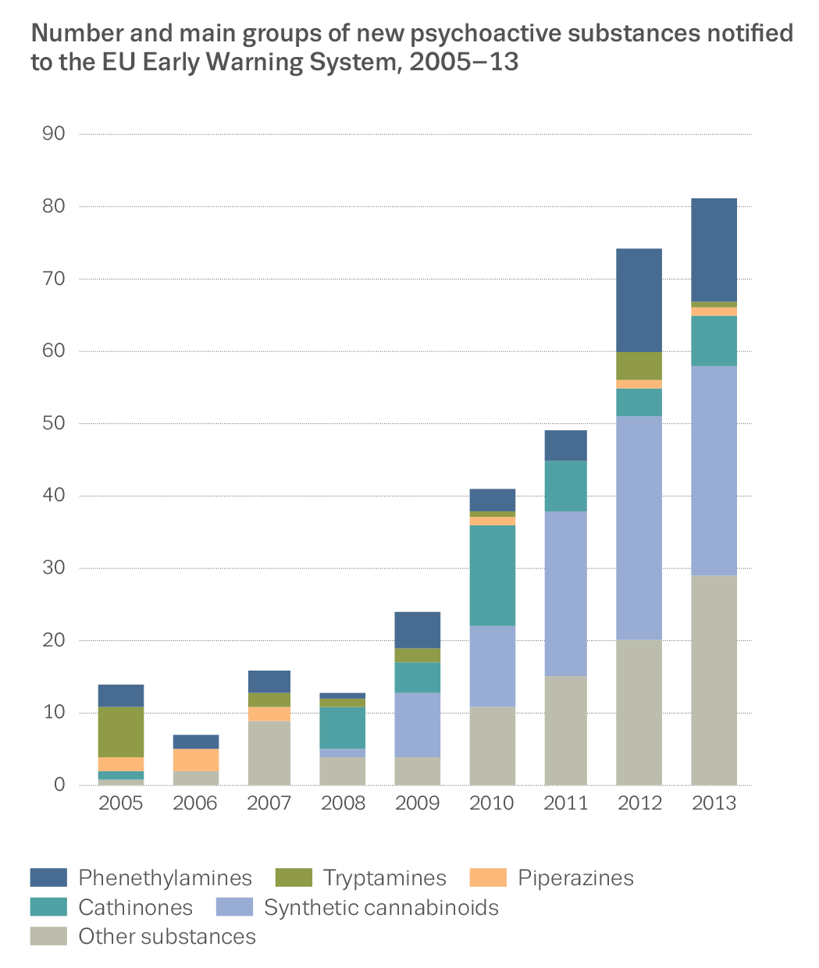
New psychoactive substances — no signs of decline
  81 reported to
  EWS in 2013
Largest group –
synthetic cannabinoids
30 ‘other’ compounds

Slide 17
Overall situation: Situation
  Increasingly complex market — with old/new drug divide becoming less relevant, new products, new channels
  Polydrug use the norm — boundaries blurred between illicit substances, NPS, medicines, alcohol
Stagnation and decline in EU heroin and cocaine indicators,
but replacement substances and NPS cause concern

Slide 18
Overall situation: Responses
Clear progress made on major public health objectives
Availability of treatment and interventions increased over the years
  National-level exceptions still a challenge
  Policies and responses that target a single substance, losing their traction

Slide 19
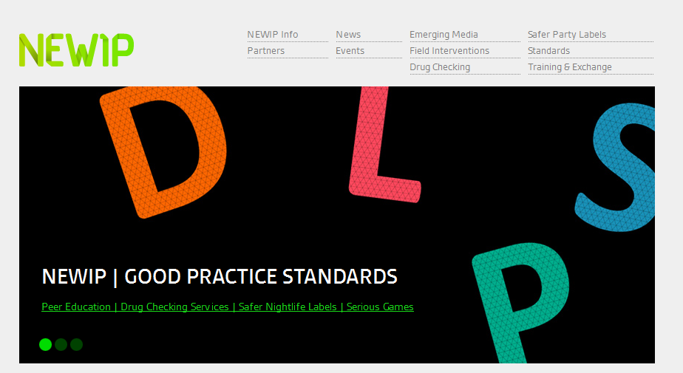
Best Practice in
Prevention

Slide 20
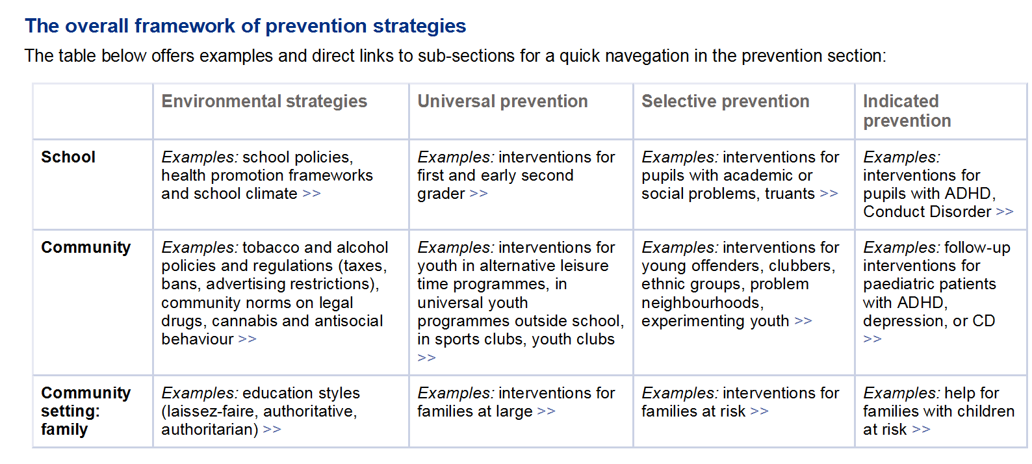
Classification of prevention interventions

Slide 21
Prevention: Some basics
What has proven to be ineffective
Information provision only
Standalone mass-media campaigns for alcohol and tobacco consumption
General approach
Early start
Overall approach targeting use of different substances

Slide 22
Prevention for community members
Comprehensive community based programmes are more effective than interventions targeting community or school only in reducing licit and illicit drug use among high risk young individuals
Multicomponent and interactive programs are effective in reducing licit drug use

Slide 23
Prevention interventions for school students
School based interventions based on social influence and/or on skill-based interventions have been proven to be effective in reducing licit and illicit drug use
interventions aimed at disadvantaged students and interventions peer-lead have shown promising results

Slide 24
Prevention interventions for families
Comprehensive family-oriented prevention interventions proved to be effective in reducing substance use (licit and illicit)
Home visitation for disadvantaged families showed effects in reducing licit substance use

Slide 25
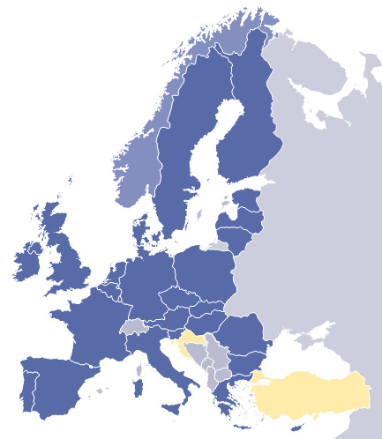
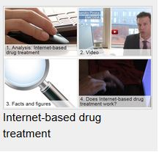
Some practical examples
School policy development
Strengthening Families Programme
Safer Nightlife
Internet based programmes

Slide 26
emcdda.europa.eu/edr2014
Thank you very much for your attention

