Slide 1
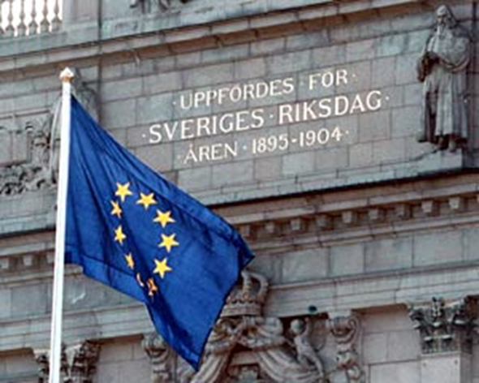
Subsidiarity checks in the Riksdag

Slide 2
The Riksdag’s work with EU affairs
The Parliamentary Committees – deliberation and information, examination of EU initiatives, subsidiarity checks.
The Chamber – debates and decisions.
The Committee on European Union Affairs – gives a mandate to the Government prior to Council meetings.
Inter-parliamentary cooperation – meetings, IPEX, network in Brussels.
The EU Coordination Unit – coordinates.

Slide 3
The role of the EU Coordination Unit
Coordinates the EU work within the parliament.
Receives and analyses all incoming EU-documents - preliminary assessment on whether a draft legislative act falls under protocol 2.
National parliament representative in Brussels.
In-house EU support and advise.
Contact point internally and externally.
Inter-parliamentary cooperation and meetings.
Follow-up of adopted legislation.

Slide 4
The legal framework
Treaty of Lisbon – National Parliaments to ensure compliance with the principle of subsidiarity.
The Protocol – Any national Parliament may within eight weeks send a reasoned opinion if they consider that the draft does not comply with the principle of subsidiarity.
The Riksdag Act – The Riksdag shall examine whether a draft legislative act conflicts with the principle of subsidiarity. The subsidiarity checks are carried out by the sectorial committees.

Slide 5
Subsidiarity checks in the Riksdag
All draft legislative acts falling under protocol 2.
Examination is carried out by the sectorial committees. The EUA Committee does not perform subsidiarity checks.
On request by the committee, the Government shall inform the committee of its assessment within 2 weeks. Explanatory memoranda within 5 weeks.
In compliance: a decision by the committee.
In breach: committee’s proposal for a reasoned opinion debated and decided by the Plenary.
Annual follow-up by the Committee on the Constitution.
So far in total 50 reasoned opinions from the Riksdag.

Slide 6
Subsidiarity checks

Slide 7
The examination
Differences in committee preparation - same criteria:
  A political examination rather than a legal review.
  A position on whether the proposed measure should be carried out at European Union or at some national level - not whether the measure is to be implemented or not.
  The subsidiarity check includes a certain element of proportionality.
  Guidelines based on protocol No 30 (1997).

Slide 8
Questions?
EU Coordination Secretariat
Abigail Choate, Head of Secretariat: +46 (0)8 786 40 00
E-mail: eu-samordningen.dok@riksdagen.se
The Riksdag’s representative in Brussels – Karin Broms
Cell. phone: +32 (0)473 94 49 38, Office: +32 2 284 23 80
E-mail: karin.broms@natparl.ep.europa.eu

